Slide 1
Budgets and Budgeting Process in the Government: Ministry of Agriculture
Suresh Chandra Babu
Senior Research Fellow and Head of Capacity Strengthening Program
International Food Policy Research Institute,
Presented at the Federal Ministry of Agriculture and Rural development
Nigeria
April 13, 2021

Slide 2
Outline
Introduction
Budgeting Government
Policy based Budgeting
Investment strategy
Task based budgeting
Budget tracking
Redefining the Budget
Conclusions

Slide 3
Introduction
Why Budgeting process is a concern?
Objective based budgeting
Components of a budget
Subsector budget
Value chain budgets (ATA)
Policy, program and project budgeting
Allocation, disbursement, spending and accounting
What are the best practices?

Slide 4
Budgeting in Government
Annual process
Federal allocation and reallocation to sectors
Managing resources to get the maximum benefits
Setting priorities for progress
Donor funds and budget support
Decentralized resource allocation

Slide 5
Objective based budgeting
NEEDS- 2
  Food security
  Land Reforms
  Agricultural Extension
  Commercialization of agriculture
  Post harvest management
  Agriculture- Industry Linkages
  Research and Training
  Subsidies
  Appropriate technologies
7 Point Agenda
  Food Security
  Wealth Creation through Agriculture
  Land Reforms
Notes:
For points two and three (Food security policy analysis and Nutrition policy analysis , we explain
Why is this problem frontier problem
Data needs
Methodology
Results (copy paste

Slide 6
Policy Based budget
Fertilizer subsidy in Malawi
FISP: Major opportunities exist to reform FISP by making it part of Malawi Social Safety Net Program.
ADMARC: Development Partners (DPs) need to do more research into how much ADMARC’s operations distort maize prices and affect food security in Malawi.
Seed Policy: DPs need to ascertain positions of key GOM stakeholders and make a stronger financial case for creating a semi-autonomous seed commission.
Source: Chingaipe and Hoffman (2017)

Slide 7
Value chain based budget
ATA in Nigeria
Agricultural transformation Investment Council (ATIC)
Agricultural Investment Transformation
NIRSAL Agricultural Transformation Implementation Group
Notes:
For points two and three (Food security policy analysis and Nutrition policy analysis , we explain
Why is this problem frontier problem
Data needs
Methodology
Results (copy paste

Slide 8
Key policies Identified under ATA (FMARD)
  Agricultural Policies
    Liberalize foundation seed policy to allow private sector to commercialize seeds
    Eliminate government distribution of fertilizers and replace with private sector distribution
    Move away from a flat fertilizer price subsidy to targeted support to small holder farmers
    Incentives to engage young commercial farmers for farming as a business
Source: ATA (FMARD)
Notes:
8
8

Slide 9
Key policies for success (FMARD)
  Agricultural Policies
    Create institutions to support the agricultural transformation agenda
      Marketing Corporations, to replace marketing boards
      Transform the Agricultural Research Council (ARCN) to a National Agricultural Transformation Agency like EMPRAPA that transformed Brazilian agriculture
    Guaranteed minimum price for food crops
    Revise the Land Use Act to enable easier access to land for investors in agriculture
    Rapid expansion in irrigation facilities and revamping of existing ones
Source: ATA ( FMARD)
Notes:
9
9

Slide 10
Supporting policies for success
  Financial Service Policies
    Incentives for access of farmers to weather index insurance to adapt to climate change
    Remove the current monopoly on agricultural insurance by the National Agricultural Insurance Company and liberalize to allow private sector insurance companies
  Industrial Policies
    Move gradually away from fertilizer consumption subsidies to support for local fertilizer manufacturing leveraging the gas industrialization policy (e.g., Nagajuna 1.4 mil MT plant)
  Market Development (Enabling Legislative Acts)
    10% Cassava Flour substitution for bread wheat flour
    Blending 10% ethanol with petrol.
Source: ATA ( FMARD)
Notes:
10
10

Slide 11
Fiscal policies for success
  Fiscal Policies
    Zero tariffs (custom, excise and value added) for import of agricultural equipment and agro-processing equipment
    Tax holidays for investors putting processing plants in staple crop processing zones
    Increase levy on any commodities that Nigeria can produce (starch, sugar and wheat)
    Current policy on import levy of 5% for brown rice and 30% for polished milled rice, and 5% on raw sugar and 10% on starches should be increased and revenue used to support domestic production
    Supportive incentives for investors establishing blending plants for ethanol
Source: ATA ( FMARD)
Notes:
11
11

Slide 12
GOAL ORIENED BUDGETING source: ATA (FMARD)
Jobs
  Over 3.5 Million jobs within 5 value chain rice, cassava, sorghum, cocoa and cotton, with many more jobs to come…
Wealth
  Over 300 Billion Naira (US$2 Billion) in additional income in the hands of Nigerian farmers
  Over 350 Billion Naira (US$2.2 Billion) injected into the economy from rice self sufficiency
  Over 60 Billion Naira (US$380 Million) injected into the economy from substituting 20% of bread wheat flour with cassava flour
Food
Security
  Enabled Nigeria to be food secure by increasing production of key food staples by 20 Million metric tons.
    Rice: 2 Million metric ton
    Cassava: 17 Million metric ton
    Sorghum: 1 Million metric tons
Source: ATA ( FMARD)
Notes:
12
12

Slide 13
USE OF PERFORMANCE INDICATORS FOR SPECIFIC SECTORS
2010
2015
Rice
Paddy
3.4 Million MT
7.4 Million MT
High Quality
Processed Rice
Negligible
2.5 Million MT
Jobs
1 Million
Cassava
Cassava Tubers
34 Million MT
51 Million MT
Yield
12.5 MT/Ha
25 MT/Ha
Jobs
1.2 Million
Sorghum
Sorghum Grain
9.3 Million MT
10.3 Million MT
Yield
0.75 MT/Ha
2.5 MT/Ha
Jobs
150,000
Cocoa
Cocoa Beans
250,000 MT
500,000 MT
Yield
300 Kg/Ha
500 Kg/Ha
Jobs
360,000
Source: ATA ( FMARD)
Notes:
13
13

Slide 14
USE OF PERFORMANCE INDICATORS FOR SPECIFIC SECTORS
2010
2015
Cotton
Cotton Lint
20,000 MT
140,000 MT
Yield
150 Kg/Ha
400 Kg/Ha
Jobs
125,000
Fertilizer
Number of
Farmers
Reached
550,000†
20,000,000
† Assumes 500,000 metric tons of fertilizer is targeted at 5 million farmers (100kg i.e. 2 bags per farmer), only reaching 11% of targeted farmers.
Source: ATA ( FMARD)
Notes:
14
14

Slide 15
Policy, program and project budgeting
Budgeting at the Subsector Level
Guided by the sector policy
Crop sector, fertilizer sector, processing sector
Agroecological budgeting
Notes:
For points two and three (Food security policy analysis and Nutrition policy analysis , we explain
Why is this problem frontier problem
Data needs
Methodology
Results (copy paste

Slide 16
3.1 Identified 10 high-potential breadbaskets in which to pilot investments - (1/2)
Cotton
Sokoto
Zamfara
Katsina
Jigawa
Yobe
Tomatoes
Kano
Borno
Kebbi
Maize
Gombe
Bauchi
Kaduna
Niger
Cassava
Adamwara
Soya beans
Plateau
Kwara
Plateau
Fct
Oyo
Nassarawa
Osun
Ekiti
Kogi
Ondo
Benue
Taraba
Ogun
Rice
Lagos
Edo
Enugu
Ebonyi
Anambra
Imo
Abia
Cross River
Delta
Bayelsa
Rivers
Akwalbom
SOURCE: Monitor; USAID; WB; IFDC; IFAD; team analysis – from Isaac Okarofor, 2011

Slide 17
Identified 10 high-potential breadbaskets in which to pilot investments - (2/2)
Sokoto
Leather
Zamfara
Katsina
Jigawa
Yobe
Kano
Borno
Kebbi
Gombe
Bauchi
Kaduna
Niger
Adamwara
Plateau
Kwara
Plateau
Fct
Oyo
Nassarawa
Oil-Palm
Osun
Ekiti
Kogi
Ondo
Benue
Taraba
Ogun
Lagos
Edo
Enugu
Ebonyi
Anambra
NIRSAL also recognizes AQUACULTURE as one of the pilot investment areas
Cocoa
Imo
Abia
Cross River
Delta
Bayelsa
Rivers
Akwalbom
SOURCE: Monitor; USAID; WB; IFDC; IFAD; team analysis – from Isaac Okarofor, 2011

Slide 18
Policy, program and project budgeting
We take Aquaculture Value chain
Review the budgeting process
Look at the value chain elements
What are the sub sectors of the Aquaculture sector
Systemic approach to budgeting
Notes:
For points two and three (Food security policy analysis and Nutrition policy analysis , we explain
Why is this problem frontier problem
Data needs
Methodology
Results (copy paste

Slide 19
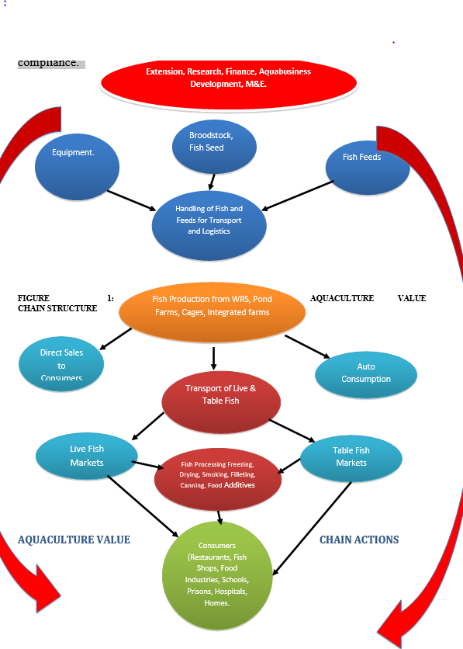
Aquaculture Value Chain – Source: FMARD
Source: ATA ( FMARD)

Slide 20
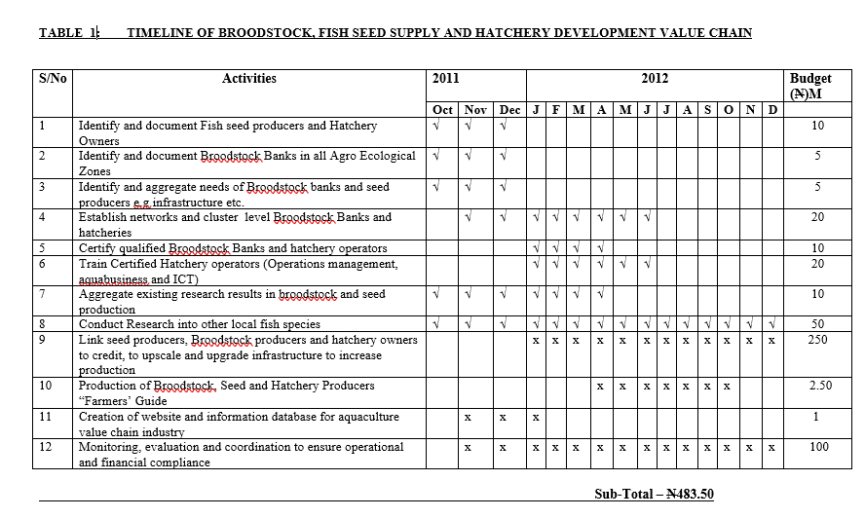
Source: ATA ( FMARD)

Slide 21
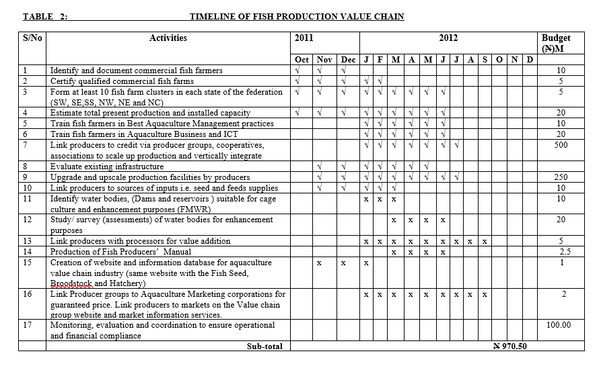
Source: ATA ( FMARD)

Slide 22
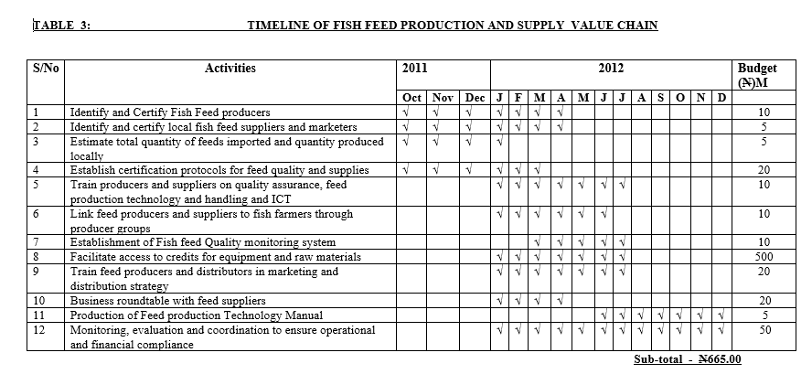
Source: ATA ( FMARD)

Slide 23
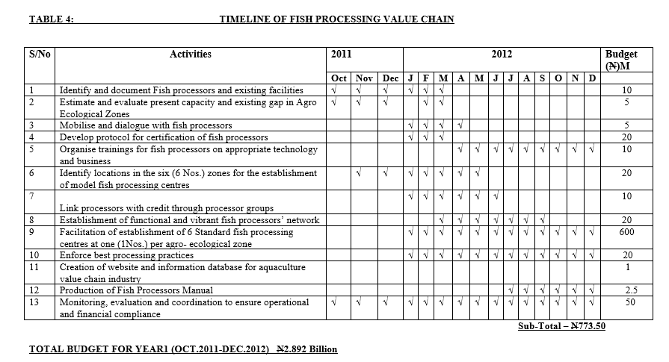
Source: ATA ( FMARD)

Slide 24
Expected Outputs
1.25 billion fish seeds per annum
Production of 400,000MT of fish feed per year
Production of 250,000MT of table size fish in a year
Create 100,000 jobs per annum for the next five years
Source: ATA ( FMARD)
Notes:
For points two and three (Food security policy analysis and Nutrition policy analysis , we explain
Why is this problem frontier problem
Data needs
Methodology
Results (copy paste

Slide 25
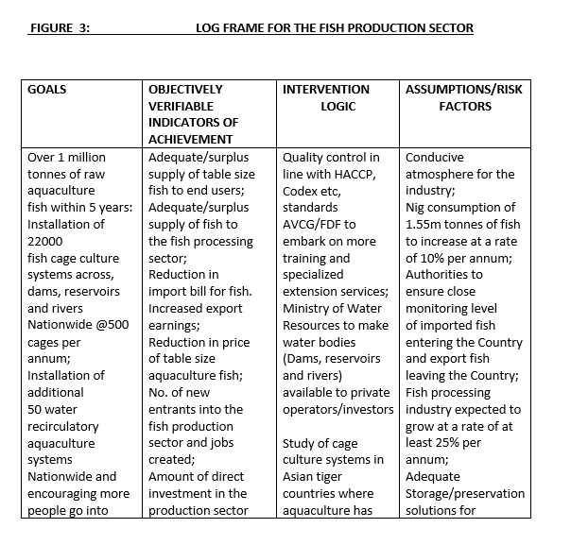
Redefining budget – midcourse correction
Source: ATA ( FMARD)

Slide 26
Budget tracking
Research and Development - ARCN
Export promotion of crops, livestock, and fisheries
Irrigation development
Promotion of Mechanization
Improved technology and innovation – cultivars, breeds, and brood stock
Extension System development
Veterinary services including vaccines and disease control
Inputs supply and distribution

Slide 27
Investment based budgeting
Shenggen Fan et al?
Where to invest for maximum returns
Roads, Research, extension ranking
Seed systems or input supply
National Agricultural Investment Plans
Notes:
For points two and three (Food security policy analysis and Nutrition policy analysis , we explain
Why is this problem frontier problem
Data needs
Methodology
Results (copy paste

Slide 28
Thank you - Q & A
Notes:
For points two and three (Food security policy analysis and Nutrition policy analysis , we explain
Why is this problem frontier problem
Data needs
Methodology
Results (copy paste

