Slide 1
Making insurance accessible in developing country contexts
Berber Kramer
Senior Research Fellow, International Food Policy Research Institute (IFPRI)
Climate Change and the Economics of World Food and Agriculture
University of Alberta, June 27th, 2021
Notes:
25-minute lecture on strengthening insurance and finance services for helping smallholder farmers to adapt to climate change.
Overview of WII and experience (positive or less positive) with the picture-based approaches.

Slide 2
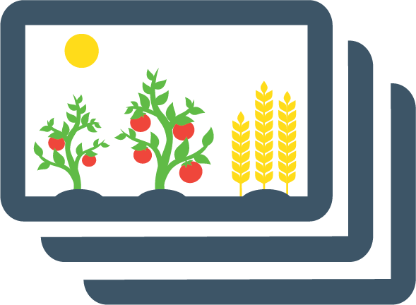


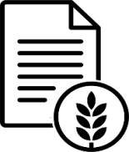
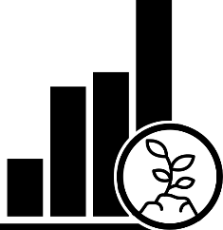

Outline
Why should smallholders have access to insurance?
Challenges in the provision of insurance
Leveraging technology for crop monitoring

Slide 3


Why insurance for smallholder farmers?
Climate change is not only increasing average temperatures, but also the frequency of extreme weather events (droughts, cyclones, floods, …) that can destroy a farmer’s livelihoods.
Since these events reduce incomes for an entire community at once (“covariate risks”), informal networks cannot really provide a safety net
Instead, rely on costly coping strategies: borrowing at high interest rates, sell productive assets (e.g., land, livestock), planting less in next season, reduce investments in schooling or health
Just anticipating climate risk already reduces investments in agriculture across the value chain!
Ex post: Insurance payouts
Timely inflow of cash to prevent costly coping strategies, and support continued investments
Insurance
Ex ante: Risk reduction, improve confidence
Improved lending and increased agricultural investments (larger areas cultivated, cash crops, better technologies)

Slide 4
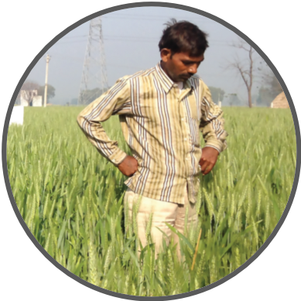
Challenges in the provision of agricultural insurance
Traditional indemnity-based insurance: Costly and risky to provide
The idea: When an insured farmer suffers damage, an insurance agent would come to the farm to verify the damage and determine how much the farmer should be paid.
This would be very costly, especially relative to the amounts that smallholder farmers are looking to insure.
Also “asymmetric information” driving up insurance premiums or crowding out markets entirely:
  Moral hazard—reduced prevention as insurer cannot observe effort
  (e.g., not irrigating the fields, letting the crops go dry)
  Adverse selection—selection of clients with higher expected payouts
  (e.g., enrolling only plots without irrigation facilities)
As a result, until recently, most farmers could not insure their crops.

Slide 5
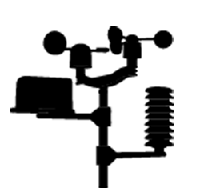
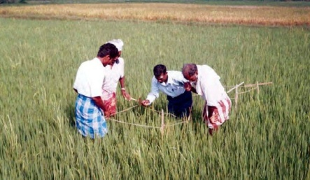
Challenges in the provision of agricultural insurance
Index-based insurance:
Index: A proxy for a farmer’s income losses that cannot be controlled or manipulated by the farmer
Examples: Weather index-based, NDVI-based, area-yield index-based
When the index reaches a “trigger” at which losses are expected to occur, a payout is made. The payout will be increasing in the index value, up until the total value that the farmer had insured.
Relying on an objective index was considered a breakthrough -> the new microfinance!
Implementation challenges:
Historical data limitations to price the insurance product
Data infrastructure (e.g., weather stations, satellite imagery processing) is needed
Low demand: cash constraints, awareness/understanding, distrust, and basis risk

Slide 6
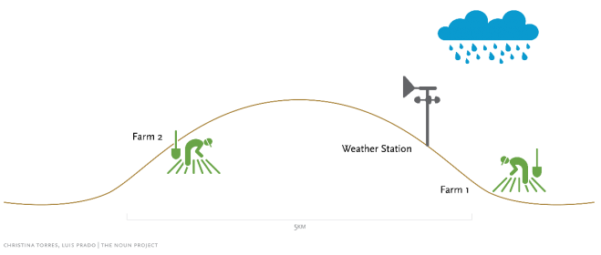
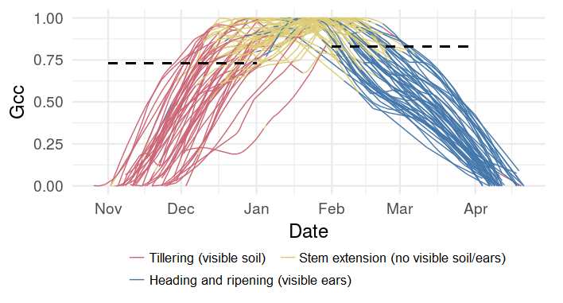
Basis risk: Index not adequately correlated with losses
1. Spatial basis risk
2. Temporal basis risk
Farm 1
Farm 2
3. Design basis risk
Even if we have spatially high-resolution data on the index, and we can accurately observe crop growth stages, we will not yet know whether losses are incurred
Modeling production losses as a function of the index requires historical data on both the index (sparse) and crop yields (even more difficult to obtain)
Designing insurance requires a multidisciplinary effort between agricultural, actuary, remote sensing and/or meteorological experts

Slide 7
Basis risk is a widespread phenomenon in insurance
Consequences of “basis risk”
Damage but no/low payouts triggered, even though farmer paid insurance premium
No damage but payout triggered, nice but increases expected payouts = premiums without adding value
Too often, weather index-based insurance acts like a lottery
2
1
Source: Clarke, Mahul, Rao and Verma (2012). Weather based crop insurance in India. World Bank Policy Research Working Paper 5985

Slide 8
Outline
Why should smallholders have access to insurance?
Challenges in the provision of insurance
Leveraging technology for crop monitoring

Slide 9

Technology to address these challenges
Remote sensing through high-resolution satellite imagery
Promising area with many institutions working in this space, developing indices based on radar / weather data, soil moisture, vegetation and water indices
Basis risk however can remain a challenge (e.g., Malawi example in the African Risk Capacity)
Satellite imagery offers limited transparency / tangibility (for farmers and insurance providers)
Mobile phones and smartphone pictures:
Reducing administrative costs (communication; filing claims; mobile money to facilitate premium payment and make insurance payouts)
Crowdsourcing of information (low-cost data collection on varieties, sowing dates, etc.) and providing a picture of the on-the-ground reality

Slide 10









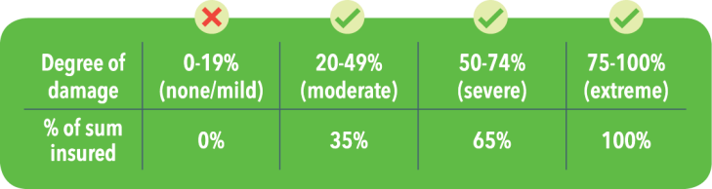





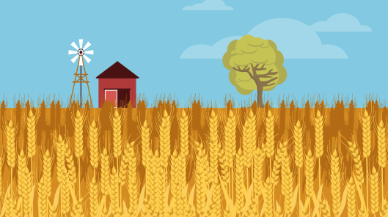

Picture-Based Insurance (PBI): Seeing through a farmer’s eyes
Taking advantage of increasing smartphone penetration in rural areas
Easy-to-understand, high farmer engagement, and reduced basis risk
Augmenting information flow to the insurer, which can be used for monitoring and improving satellite-based indices

Slide 11
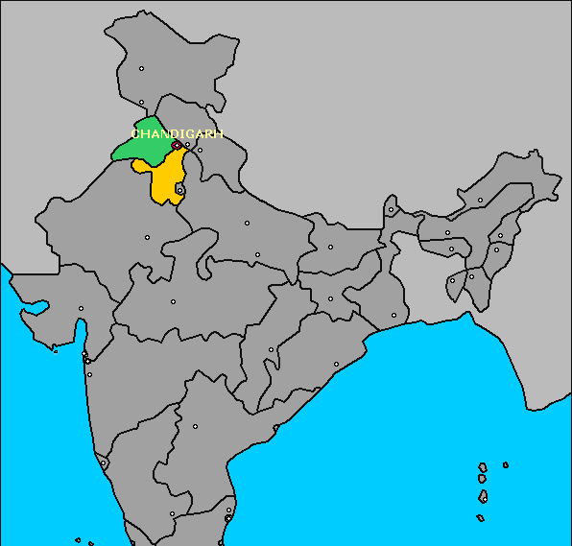
Early work: Formative evaluation
Punjab
Haryana
Cluster Randomized Trial in Haryana and Punjab, India
50 villages, 750 wheat producers
RESULTS:
Considerable farmer engagement
  67% of invited farmers provided at least one picture per month
  Many farmers liked visiting plot more often
Picture-based monitoring helps reduce basis risk
  Particularly suitable for severe damage (where index-based insurance performed poorly)
The approach improves demand for insurance
  Higher willingness to pay for PBI, but still below actuarially-fair premiums in the case of India
No evidence of tampering or moral hazard
  No tampering or fraud observed (manual review of pictures)
  No moral hazard: Similar input use and yield as farmers with weather index-based insurance
Ceballos, Kramer & Robles (DevEng, 2019), Hufkens et al. (AFM, 2019), Ceballos & Kramer (IFPRI, 2019)

Slide 12
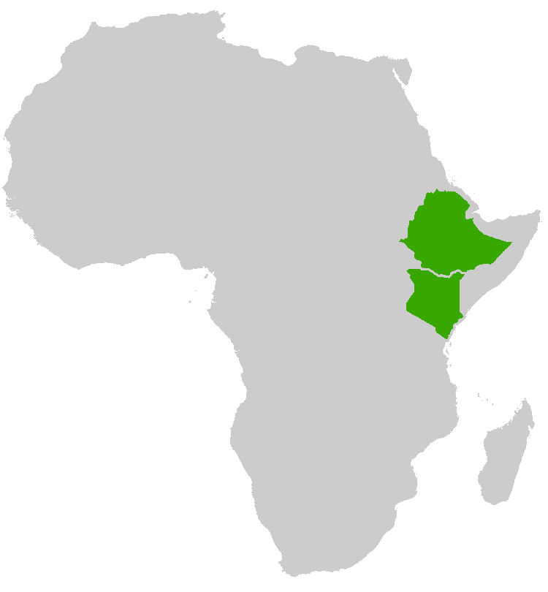
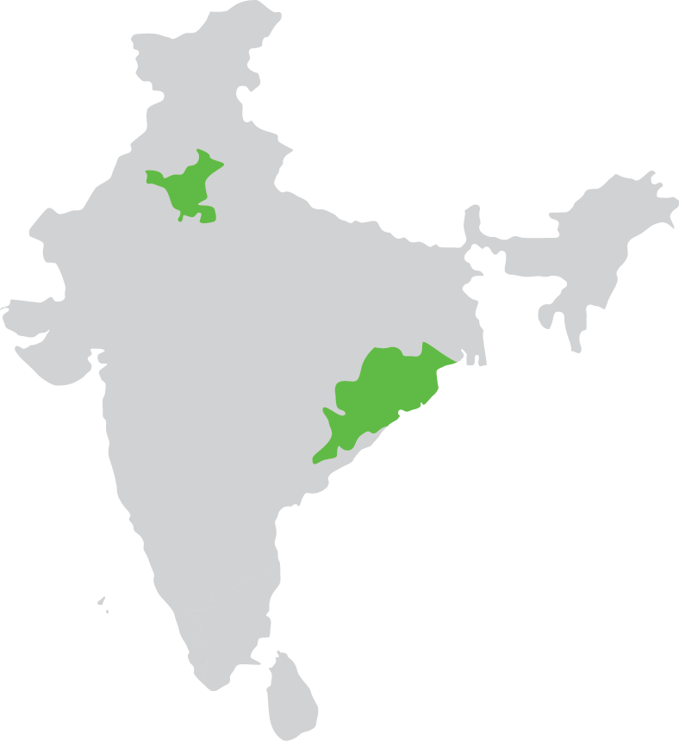
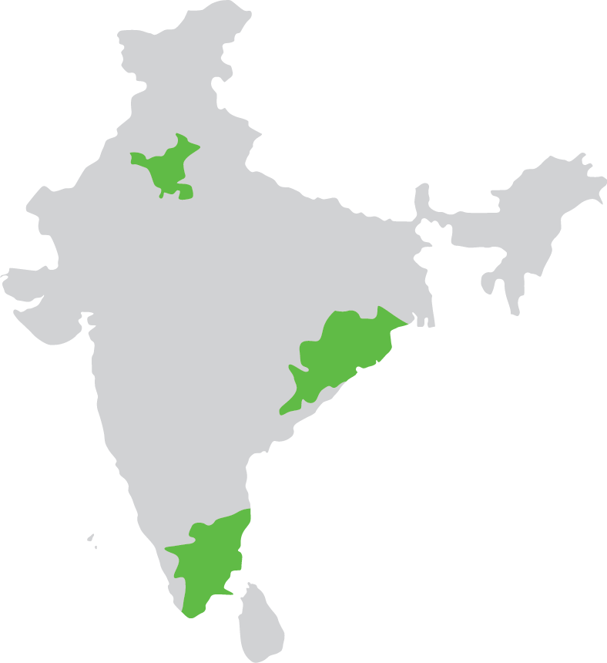
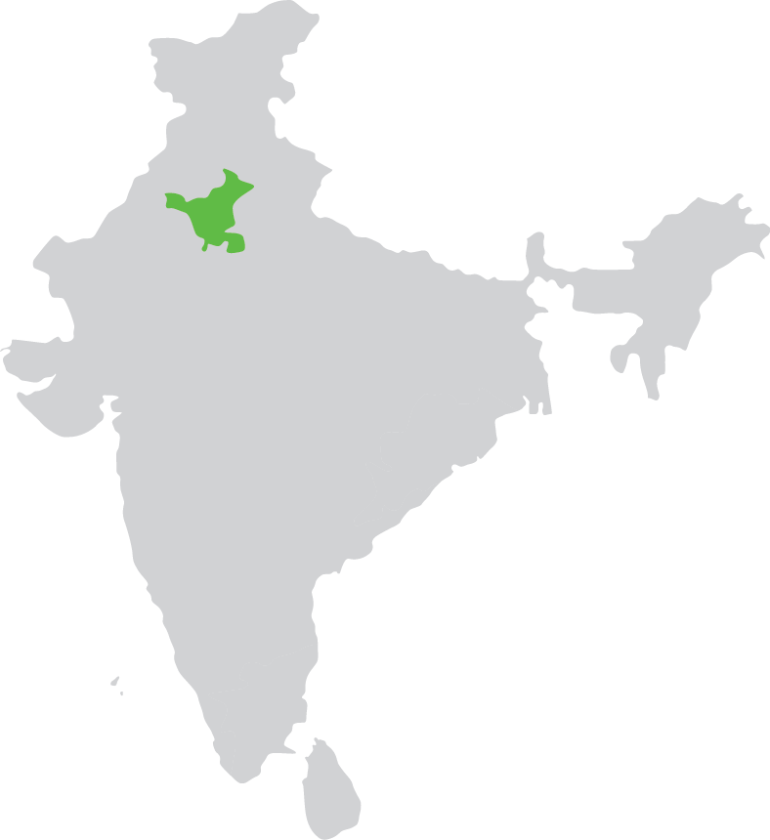
Current trials with applications of picture-based insurance
HARYANA:
Providing social safety net (“state-contingent cash transfers”) for marginalized vegetable producers
ETHIOPIA:
Monitoring basis risk in R4 Rural Resilience Initiative
1
6
5
KENYA:
Bundling with seeds of stress-tolerant varieties
2
ODISHA:
Insure digital agricultural microfinance loans (“picture-based credit”)
3
4
TAMIL NADU:
Bundling with “picture-based advisories” around integrated pest management
ALL INDIA:
Testing tools for yield estimation in national insurance scheme (PMFBY)

Slide 13
Challenges in providing picture-based insurance
Farmers’ smartphone access and literacy: Existing digital divides could exclude under-privileged groups from reaping benefits, unless working with village-based agents (as we do in Kenya & Ethiopia).
High start-up costs: Set up training and distribution channels, collect images of targeted crops to assess the visibility of damage, and calibrate software for automated image processing.
Pricing: Can be tricky without comprehensive, disaggregated historical data on crop damage, and so we integrate PBI into weather, vegetation, or area-yield index products, but this increases premiums.
Regulatory environment: Constraints within existing regulatory frameworks if offered as stand-alone indemnity insurance – provide, for now, as a fail-safe trigger for index insurance – again at a cost
Moral hazard and adverse selection: We have not found empirical evidence so far, but important to keep monitoring, and to analyze how products can be designed to overcome such challenges.
Overall low take-up of crop insurance: Integrate insurance for the poor into social protection schemes, and public investments in infrastructure to facilitate coverage for the vulnerable non-poor.

Slide 14
Key messages
Why should smallholders have access to insurance?
Improve coping with weather shocks: Reduce farmers’ reliance on costly coping strategies
Promote investments in agriculture by reducing risk, increasing confidence, and access to credit
Challenges in the provision of insurance
Indemnity-based insurance: One cannot sustainably have insurance agents verify losses for every farmer filing a claim
Index insurance: Suffers from data limitations and low demand, often resulting from basis risk
Leveraging technology for crop monitoring: A way forward?
Digital technologies, for instance smartphone pictures, can help monitor crops at limited cost, and enable indemnity-based insurance
But also: Bundling with other instruments to manage risk (e.g., credit, inputs, advisories, integrate in social protection programs) to provide more complete solutions and leverage existing distribution channels
Major evidence gap: Costs and benefits of subsidies and other public investments for different segments of farmers to justify public investments

Slide 15
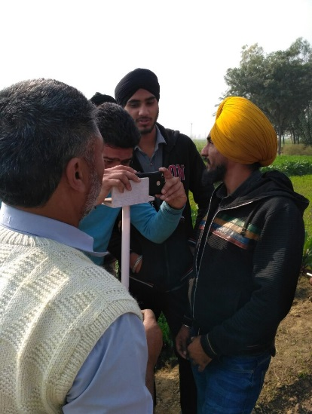
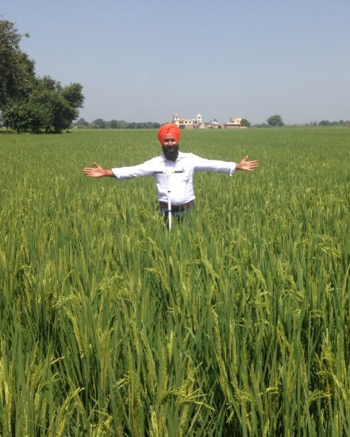
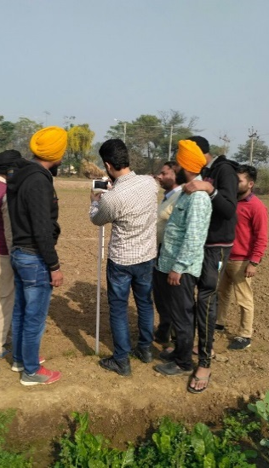
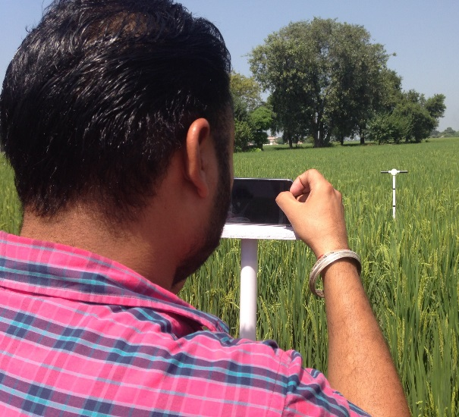
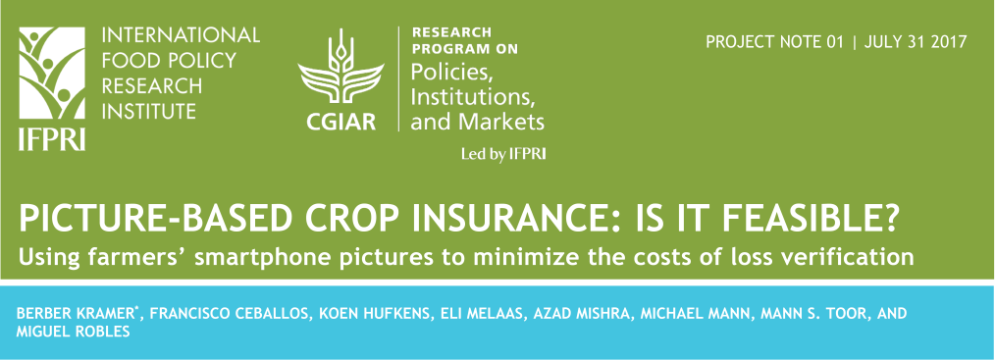

For more information: B.Kramer@cgiar.org
More available at: https://www.ifpri.org/project/PBInsurance
THANK YOU!
Notes:
Talk more about the challenges.

