Slide 1
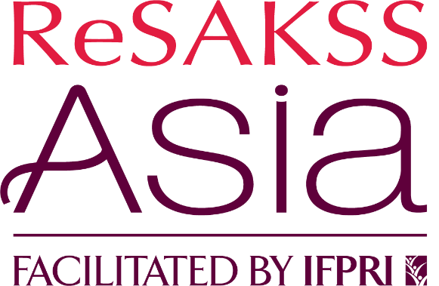
Gender perspective in lentil farming and business- lessons for Nepal
Suresh Babu
IFPRI, Washington, DC
The Future of Lentil Systems in Nepal: Workshop and Expert Perspectives on Lentil Production Systems and Potential Opportunities
December 15 - 16, 2021

Slide 2
Outline of the presentation
Gender issues in Lentil production and marketing
Analytical framework
Policy perspectives
Institutional perspectives
Farm production perspectives
Marketing and agrobusiness perspectives
Research needs
Concluding remarks

Slide 3
Literature and sources informing this presentation
FAO. 2019. Country gender assessment of agriculture and the rural sector in Nepal. Kathmandu.76 pp
Dina Najjar, International Center for Agricultural Research in the Dry Areas (ICARDA)
Protecting Ethiopian Lentil Crops Initiation Workshop, October 11-13, 2021
Recent reports from priority setting and technical workshop with the Ministry of Agriculture and IIDS under USAID – FTF – Food Security Innovation Lab on Policy research, Capacity and Influence (MSU, IFPRI, and IIDS – June and September 2021)
PRCI and KISAN II workshop on Policy Analysis Training for Officers of the Government of Nepal (8-12 March 2021, Kathmandu, Nepal)
Other USAID and donor funded projects

Slide 4
Gender and Social Inclusion Dimensions in Farming Systems
Access to resources, assets and opportunities
Control over resources, assets and opportunities
Benefit from resources, assets and opportunities
Gender Equality, Female Empowerment, Youth Engagement reduce disparities
Increase women/ girls capability for their rights, life outcomes, decision-making
Access to inputs, labor, and markets for processed products
Inclusion of women in the value chain development
Empowerment of women farmers in the form of farmer producer organizations

Slide 5
Objectives of Gender Equality and Social Inclusion Analysis
OBJECTIVES
Classify patterns of power & decision-making
Identify cultural norms, beliefs, practices and gender-based barriers
Identify positive trends, models on gender roles and socio-norm
Analyze challenges and constraints to access and control of assets and resources
(Source: CARE implemented USAID funded project Titukulane)

Slide 6
Broad results from the literature on gender analysis applicable to Nepal
Human capacity – skills, knowledge, and participation needs improvement
Equality in decision making and in control of the benefits often depends on access and ownership of assets and resources.
Women and youth do not have same access assets, technology, markets, and other benefits from interventions
Culture, norms, and beliefs play important role in women empowerment
Interventions should involve both men and women

Slide 7
Gender Issues Lentil farming systems
Role of Lentil in faming system as they affect gender issues?
Is Lentil a women crop?
What share of income does Lentil constitute Women’s income?
Is lentil production subsistence, commercial, or a nutrition- oriented?
Based on the above, what traits are needed for promoting Lentil in Nepal farming system?
What are the preferences for marketing and commercial production?
What issues arise when women try to adopt lentil in the farming system and try adopt specific varieties from their preferences?
What policy, institutional, technology changes (breeding and other innovations) needed?

Slide 8
Policy perspectives
Gender-bias exists at policy and legislative levels. Eg: Ensuring women’s ownership of land is still a challenge.
Gender equality policies and laws not implemented on the ground for the benefit of rural women.
Government policy should go beyond from program and project participation to gender inequalities in agriculture and the wider rural economy.
Gender gaps in agriculture - lower adoption of modern varieties by women lentil producers
Linking food and nutrition outcomes in policy
Reference: FAO. 2019. Country gender assessment of agriculture and the rural sector in Nepal. Kathmandu.76 pp

Slide 9
Production and technology perspectives
Gender gaps in production agriculture
Lower adoption of modern varieties by women lentil producers
Consequences of Lentil production for the women nutrition and food security outcomes.
Breeders are concerned to make lentil production women friendly – what are the varietal preferences?
How to include more women in the benefits of MVs?

Slide 10
Results from the Ethiopian Study on Gender Analysis of Lentil production (Dina Najjar, International Center for Agricultural Research in the Dry Areas (ICARDA))
Resistance to rust
Market price
Yield/productivity
Taste
Ability to split properly (+traders and processors)
Ability to dry without spoiling (storage) (+traders and processors)
Amount of residue

Slide 11
Marketing oriented interventions
Identify select agriculture cooperatives and farmer groups to encourage collective marketing.
Improve capacities of the selected lentil producing cooperatives and farmer groups
Agricultural Knowledge Centers should provide strong mentoring support for women lentil production
Create necessary marketing infrastructure for women to participate in lentil marketing including access to digital agriculture

Slide 12
Thank you – Q&A

