Slide 1
Why is Food Utilization an Important Component of Food Security?
Evidence-Based Rationale for Bangladesh
Akhter Ahmed
Country Representative for Bangladesh
International Food Policy Research Institute
Training Workshop on Concepts and Tools for Policy Analysis
Dhaka | 26 February 2018

Slide 2
Food Security:
Conceptual Framework

Slide 3
Why is food utilization important component of food security?
Food security: Access by all people at all times to sufficient food to meet their dietary needs for a healthy and productive life. 3 components:
Availability of adequate food at the national level.
Access to adequate food at household and individual levels.
Effective biological utilization of food.
Availability of and access to adequate food are necessary, but not sufficient for a healthy life. Hence, the third essential element of food security is the effective biological utilization of food, which depends on many factors (e.g., health and sanitation, household or public capacity to care for the vulnerable).
The ultimate goal of ensuring food security is to improve the well-being, health, and nutrition of the population.

Slide 4
Conceptual Framework
Child Nutrition
Food/Nutrient Intake Health
Immediate Causes
Availability of food
Access to food
Maternal & Child Care Practices
Water, Sanitation & Health Services
Underlying Causes
Source: Adapted from UNICEF 1990

Slide 5
What are the main food availability and food access issues for nutrition in Bangladesh?
Availability
Bangladesh has made remarkable progress in foodgrain production, but improvements in child and maternal nutrition warrant further attention.
Agriculture provides a source of food and nutrients, a broad-based source of income, and affects food prices. Given these links, agriculture has the potential to be a strong driver of nutrition. However, that potential is not being realized.
Access
Social safety nets are important for improving food access for the poor, and have been quite effective in smoothing the consumption and the income of poor households in Bangladesh.
However, most existing evidence from evaluations (by IFPRI and others) of major safety nets in Bangladesh show few improvements in child nutritional status. This leads to a key question: Are there constraints other than income, such as nutrition knowledge, that also need to be addressed?

Slide 6
IFPRI has created a comprehensive dataset for food policy analysis in Bangladesh
IFPRI’s Bangladesh Integrated Household Survey (BIHS): most comprehensive rural household panel survey to date.
4 unique features of data collection:
Plot-level agricultural production
Individual food intakes of all HH members
Anthropometry measurements of all HH members
Data to measure the Women’s Empowerment in Agriculture Index (WEAI)
BIHS sampling is statistically representative:
nationally of rural Bangladesh
rural areas for each of the 7 administrative divisions
USAID-supported Feed the Future Zone in southern Bangladesh

Slide 7
Relationship between GDP growth, agricultural growth and stunting in Bangladesh: 1997–2011
Source: BBS, various years; DHS, various years

Slide 8
Understanding Food Utilization:
Nutrition Scenario in Bangladesh

Slide 9
Investments in nutrition have high returns
Economic returns to US$ 1 invested in reducing stunting
The return is $18.40 in Bangladesh
Source: Hoddinott et al. 2013, IFPRI; Eggersdorfer et al. 2013

Slide 10
Bangladesh has been one of the most successful countries at reducing preschooler stunting rates
Source: DHS, various years

Slide 11
Sources of change in child growth outcomes in Bangladesh (HAZ scores), 1997-2011
Source: Heady et al. 2014 (IFPRI)

Slide 12
Despite decline, more than 1/3 of under-5 children are still stunted
Source: DHS, various years

Slide 13
There is no room for complacency—we must accelerate reductions in child stunting

Slide 14
Stunting for under-5 children reduces as income increases, yet sizable number of children from rich households are stunted
Source: BIHS 2011/12

Slide 15
Regional differences in percentage of under-5 children who are stunted
Source: DHS 2011 and 2014

Slide 16
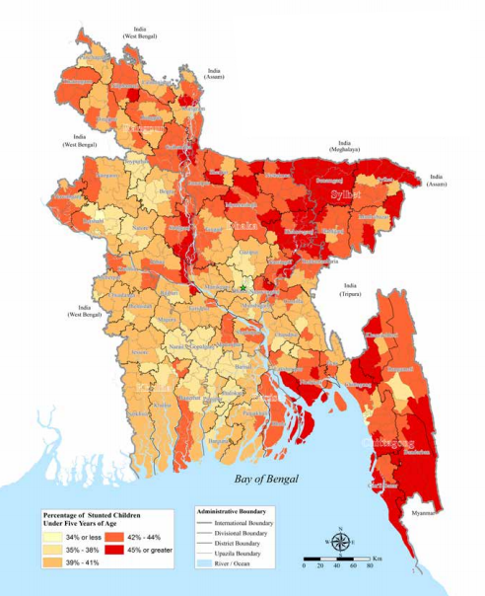
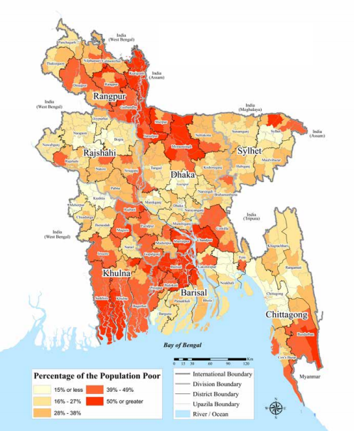
A paradox: stunting is highest in regions of lowest poverty, and vice versa
Child stunting
Poverty
Source: WFP 2012

Slide 17
Paradox is partly explained by regional difference in women’s empowerment
Sylhet Division: lowest women’s empowerment, second highest income
Barisal Division: second highest women’s empowerment, second lowest income
Source: IFPRI BIHS 2015

Slide 18
High rate of adolescent pregnancies is associated with stunting in Bangladesh
IFPRI BIHS data show:
58% of girls in rural areas get married before age 18
Adolescent girls aged <19 account for 36% of all child births in rural Bangladesh
Early marriage→ Early pregnancy → Low birthweight→ Stunting
Source: IFPRI BIHS 2015
Source: DHS 2014

Slide 19
Prevalence of overweight increases as income increases
(measured by BMI age-specific cutoffs)
Source: IFPRI BIHS 2011/12

Slide 20
Dietary Diversity Measures
IYCF indicators
 | Household DD | Women’s DD | Minimum DD | MAD
Target Population: | All household members | 15-49 years | 6-23 months | 6-23 months
# of Food Groups: | 12 | 9 | 7 | 6 (non-breastfed) 7 (breastfed)
Reference Period: | 24-hour recall | 24-hour recall | 24-hour recall | 24-hour recall
Proxy measure for food security
Individual measures are good indicators of diet quality

Slide 21
Household’s Dietary Diversity Improved (12 food groups)
Source: IFPRI BIHS 2011/12 and 2015

Slide 22
Women’s Dietary Diversity Improved Slightly (9 food groups)
Source: IFPRI BIHS 2011/12 and 2015

Slide 23
Minimum Acceptable Diet for Children 6-23 Months Improved (4 out of 7 food groups for breastfed children)
Source: IFPRI BIHS 2011/12 and 2015

Slide 24
Calculation of the WFP Food Consumption Score to Measure Diet Quality (# of days consumed of each food group in past 7 days, weighted by “nutritional importance”)

Slide 25
Household Diet Quality Improved (Estimated WFP’s Food Consumption Score: 0-112)
Average FCS
Percentage of households with low FCS (<42)
Source: IFPRI BIHS 2011/12 and 2015

Slide 26
Household Diet Quality is Worse for the Poor, but Quality Improved for All (using WFP’s Food Consumption Score: 0-112)
Source: IFPRI BIHS 2011/12 and 2015

Slide 27
Percentage of Households With Low Diet Quality Declined (using WFP’s Food Consumption Score: 0-112)
Source: IFPRI BIHS 2011/12 and 2015

Slide 28
Frequency of Food Groups Consumed in Past 7 Days Increased on Average
Source: IFPRI BIHS 2011/12 and 2015

Slide 29
Proportion of People Who Have Not Consumed Food Groups in Past 7 Days Declined Average food consumption frequency hides severity
Source: IFPRI BIHS 2011/12 and 2015

Slide 30
What Factors Affect Diet Diversity? Random-effects GLS Panel Regression Results Dependent variable: Food Consumption Score

Slide 31
What Factors Affect Diet Diversity?
Using random effects panel regression, we estimated determinants of diet diversity using two different measures – FCS and HDDS. We obtain similar results from both regressions. We find that diet diversity improves if:
Household male head and female spouse have higher levels of education
Agricultural diversity increases: Household grew higher number of non rice food crops last year
Women are more empowered (measured by WEAI)
Rice price increases
Household have higher number of milking cows and are engaged in fisheries
Non-farm income share increases; have access to electricity, own cell phone and have higher asset holdings.

Slide 32
Nutrient intakes by income groups
Source: IFPRI BIHS 2011/12

Slide 33
Males have higher calorie intake for all age groups
Source: IFPRI BIHS 2011/12
Notes:
Maybe delete.

Slide 34
But females have slightly higher calorie adequacy
(taking individual’s activity levels into account)
Source: IFPRI BIHS 2011/12
Notes:
Maybe delete.

Slide 35
Desirable dietary patterns and actual food intakes Gaps reduced from 2011/12 to 2015
Source a: Desirable Dietary Patterns (DDP) 2013
Source b: IFPRI BIHS 2011 and 2015

Slide 36
Addressing Food Availability: Nutrition-Sensitive Agriculture

Slide 37
Most farmers grow one crop – Rice
Source: IFPRI BIHS 2011/12

Slide 38
Overwhelming dominance of rice in diet Share of nutrient from rice of total nutrient intake
Source: IFPRI BIHS 2011/12

Slide 39
Share of Rice Decreased and Non-Rice Food Crops Increased in Total Cropped Area
Source: IFPRI BIHS 2011/12 and 2015

Slide 40
Crop Diversity Increased: Simpson Diversification Index by Division
The Simpson diversification index is calculated as $SDI=1− \sum_{i=1}^{n}{P_{i}^{2}}$,
where P_{i} is the proportionate area of the i^{th} crop in gross cropped area.
Source: IFPRI BIHS 2011/12 and 2015

Slide 41
Crop Diversity Increased: Herfindahl-Hirschman Diversification Index by Division
The Herfindahl-Hirschman diversification index is calculated as $HHDI=1−\sum_{i=1}^{n}{S_{i}^{2}}$,
where S_{i} is the proportionate value of the i^{th} crop in gross value.
Source: IFPRI BIHS 2011/12 and 2015

Slide 42
Challenges for Agricultural Diversification
Year-to-year price fluctuations are much larger for non-rice crops than for rice, indicating relatively high levels of market-induced risks for production of non-rice crops
High-value crops, especially fruits and vegetables, have thin domestic markets owing to relatively low levels of demand for them
Horticultural crops, milk, and fish also face special problems related to perishability, which increases the risks of marketing
The interplay of these factors contributes to the low level of agricultural diversity in Bangladesh.

Slide 43
Influence of Agriculture on Diet Quality Evidence from IFPRI research in Bangladesh
Increased agricultural diversity improves household dietary diversity (Sraboni et al. 2014)
Increased women’s empowerment in agriculture (measured by WEAI) helps
Improve household, child, and maternal dietary diversity; (Sraboni et al. 2014)
Increase agricultural diversity (Ahmed & Sraboni 2014)
Nutrition behavior change communication (BCC) training for women and men improves household diet quality, child nutrition and complementary feeding practices (TMRI: Ahmed et al. 2016; A&T: Menon et al. 2016).

Slide 44
Agriculture, Nutrition, and Gender Linkages (ANGeL) Project: Background
Motivated by IFPRI research findings, IFPRI researchers developed a concept note for the Ministry of Agriculture to strengthen the agriculture-nutrition-gender nexus in June 2014.
Government approved ANGeL project in September 2015 for implementation by Ministry of Agriculture.
On October 29, 2015, Honorable Minister of Agriculture launched the ANGeL project.
ANGeL draws on the government’s nationwide agricultural extension network, ‘topping-up’ their portfolio with nutrition activities and messages.

Slide 45
ANGeL Project Design
ANGeL is an experimental project implemented by the Ministry of Agriculture in 16 of 64 districts in Bangladesh.
IFPRI evaluates impacts of 3 interventions and their 5 combinations using clustered randomized controlled trial (RCT) method. Interventions are:
Agriculture Production: Facilitating the production of the high-value food commodities rich in essential nutrients. The focus is on diversifying agricultural production (fruits and vegetables, pulses, oilseeds, poultry, dairy, fish, livestock)
Nutrition BCC: Imparting high-quality behavior change communication (BCC) to farmers to improve nutrition.
Gender Sensitization: Undertaking activities to improve status of women, and gender parity between women and men.

Slide 46
ANGeL – Way Forward
After 2 years, the ANGeL experimental research will identify which interventions most effectively increase agricultural diversity, increase farmers’ income, improve nutrition, and promote women’s empowerment.
The Ministry of Agriculture plans to use the research-based evidence to scale up the most effective interventions all over Bangladesh.
ANGeL is the first ministry-led initiative that uses a rigorous impact evaluation (RCT) to develop an evidence base to design and implement a national program.

Slide 47
Addressing Food Access: Nutrition-Sensitive Social Protection

Slide 48
IFPRI research shows cash transfer + nutrition education has greatest impact on child nutrition
IFPRI designed an experiment called the Transfer Modality Research Initia­tive (TMRI).
WFP implemented TMRI from 2012-2014 to determine what combination of cash, food, and nutrition behavior change communication (BCC) in safety nets brings the greatest benefits for ultra-poor rural households.
Cash + nutrition BCC led to a 7.3 percentage points decrease in child stunting over the project period—almost three times greater than national aver­age decline in stunting.

Slide 49
Adding BCC increases the frequency of several food groups consumed by children <42 months: North TMRI results

Slide 50
Policy Considerations for Improving Food and Nutrition Security

Slide 51
Build Synergies Across 3 Components of Food Security
Access
Availability
Utilization
Food Security
Nutrition-Sensitive Agriculture
Nutrition-Sensitive
Social Protection

Slide 52
Policy Considerations: Nutrition-Sensitive Agriculture (1 of 3)
Promote agricultural diversity:
Reduce risk of high-value, high nutritive value food production via contract farming, agricultural credit, etc.
Create an enabling policy environment for the private sector for agricultural value chains development.
Invest in research on productivity of rice, non-rice crops, livestock, and fisheries.
Promote rice intensification and agricultural diversification via agricultural extension.

Slide 53
Policy Considerations: Nutrition-Sensitive Agriculture (2 of 3)
Promote biofortified crop production
HarvestPlus and BRRI developed 4 varieties of zinc-fortified rice.
HarvestPlus is also working with BARI on biofortified lentil and sweet potatoes.
Ministry of Food through its Public Food Distribution System (PFDS) can procure zinc-fortified rice from farmers at a premium price, which can incentivize farmers to grow biofortified rice.
Promote distribution of biofortified crops in safety nets
PFDS can create institutional demand for biofortification by distributing zinc-fortified rice to safety net programs as PFDS outlets.

Slide 54
Policy Considerations: Nutrition-Sensitive Agriculture (3 of 3)
The ANGeL project, designed by IFPRI and implemented by the Ministry of Agriculture, is promoting nutrition-sensitive agriculture.
Improve diet quality:
Develop value chains for nutrient-dense foods.
Promote nutrition knowledge among consumers, farmers, and women and men.
Support women’s empowerment:
Women’s empowerment in agriculture improves dietary diversity, increases agricultural diversity, and helps households move out of poverty (IFPRI 2016). Therefore, promoting women’s empowerment remains paramount to attain complementary development goals.

Slide 55
Policy Considerations: Nutrition-Sensitive Social Protection (1 of 2)
Revamp existing safety net programs:
Add nutrition BCC to social protection, which covers
Distribute fortified rice (pushti chal) through the Vulnerable Group Development (VGD) program and the new Khaddya Bandhob (Food Friendly) Program.
Introduce school feeding program in secondary schools:
School feeding program in Bangladesh currently operates only in primary schools.
Introducing school feeding program in secondary schools is a promising platform to target nutrition interventions to reach adolescents, particularly girls.

Slide 56
Policy Considerations: Nutrition-Sensitive Social Protection (2 of 2)
Improve targeting:
Target the poor
Target geographically: coastal belts, urban slums, low income areas.
Target vulnerable population groups: using a lifecycle approach (adolescent girls, pregnant and lactating women).
Looking forward, design evidence-based safety nets to improve nutrition outcomes:
GoB has committed to introduce a national Child Benefit Program under the National Social Security Strategy (NSSS). IFPRI and WFP are currently discussing with the Government on the design, which may include high quality nutrition BCC and targeting adolescent girls, and pregnant and lactating women.
Notes:
Add targeting point.

Slide 57
Policy Considerations:
Prevent Early Marriage
Prevent early marriage of girls
Pregnancy in girls who are still growing leads to competition between the mother and the fetus for access to nutrients, a battle which the fetus invariably loses, which leads to low birthweight.
Low birthweight is strongly associated with child stunting.
IFPRI’s qualitative results found that girls marry early due to (1) harassment by male youth, and (2) avoid paying higher dowry.
A massive social campaign is needed to increase the age of marriage, as well as to postpone pregnancy of those girls who do marry early.
To delay pregnancy after marriage, promote effective family planning.
Notes:
Compact2025 – determinants of nutrition.
Sanitary napkins.

Slide 58
Policy Considerations:
Improve WASH and Caring Practices
Improve water, sanitation, and hygiene (WASH) practices
Nutrition is not just food consumption; it’s also the ability to utilize and absorb nutrients. Improved WASH reduces the likelihood of infection (e.g., diarrhea), so the body is able to utilize the food consumed.
Access to WASH is linked to child stunting reduction.
Messages on WASH practices can be incorporated into high quality BCC programs.
Improve maternal and child care practices, such as exclusive breastfeeding for 6 months, infant and young child feeding (IYCF), provide workplace childcare options (e.g., target RMG sector), etc.

Slide 59
For more information, please contact: Akhter Ahmed
a.ahmed@cgiar.org | 01760744486
Thank you

