Slide 1

Why is Nutrition an Important Component of Food Security?
Evidence-Based Rationale for Bangladesh
Akhter Ahmed
Country Representative for Bangladesh
International Food Policy Research Institute
Training Workshop on
Concepts and Tools for Food Policy Analysis
Dhaka | 1 March 2019

Slide 2
Food Security:
Conceptual Framework

Slide 3
Why is nutrition an important component of food security?
Food security: Access by all people at all times to sufficient food to meet their dietary needs for a healthy and productive life. 3 components:
  Availability of adequate food at the national level.
  Access to adequate food at household and individual levels.
  Effective biological utilization of food.
Availability of and access to adequate food are necessary, but not sufficient for a healthy life. Hence, the third essential element of food security is the effective biological utilization of food, which depends on many factors (e.g., health and sanitation, household or public capacity to care for the vulnerable).
The ultimate goal of ensuring food security is to improve the well-being, health, and nutrition of the population.

Slide 4
Conceptual Framework
Child Nutrition
Food/Nutrient Intake Health
Immediate Causes
Availability of food
Access to food
Maternal & Child Care Practices
Water, Sanitation & Health Services
Underlying Causes
Source: Adapted from UNICEF 1990

Slide 5
Understanding Food Utilization:
Nutrition Scenario in Bangladesh

Slide 6
Investments in nutrition have high returns
Economic returns to US$ 1 invested in reducing stunting
The return is $18.40 in Bangladesh
Source: Hoddinott et al. 2013, IFPRI; Eggersdorfer et al. 2013

Slide 7
Bangladesh has been one of the most successful countries at reducing preschooler stunting rates
Source: DHS, various years

Slide 8
Regional differences in percentage of under-5 children who are stunted
Source: DHS 2011 and 2014

Slide 9
Evidence from IFPRI’s Bangladesh Integrated Household Survey (BIHS) Data

Slide 10
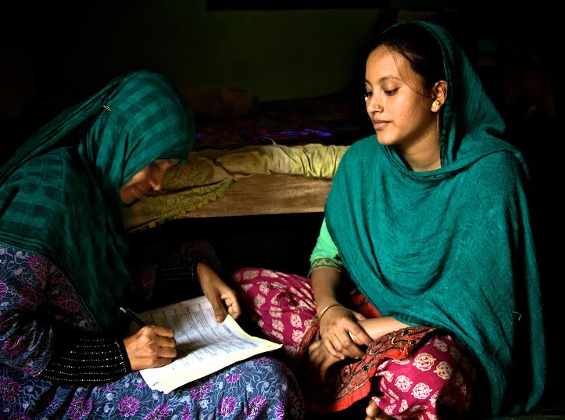
IFPRI has created a comprehensive dataset for food policy analysis in Bangladesh
IFPRI’s Bangladesh Integrated Household Survey (BIHS): most comprehensive nationally rural household panel survey to date.
3-round panel survey:
  Round 1: 2012
  Round 2: 2015
  Round 3: 2019
4 unique features of data collection:
  Plot-level agricultural production
  Individual food intakes of all HH members
  Anthropometry measurements of all HH members
  Data to measure the Women’s Empowerment in Agriculture Index (WEAI)

Slide 11
Most Bangladeshi farmers grow one crop – Rice
Source: IFPRI 2012 Bangladesh Integrated Household Survey (BIHS)

Slide 12
Overwhelming rice dominance in Bangladeshi diet
Share of rice in total nutrient intakes
Source: IFPRI 2012 Bangladesh Integrated Household Survey (BIHS)

Slide 13
Nutrient intakes by income groups
Source: IFPRI BIHS 2011/12

Slide 14
Stunting for under-5 children reduces as income increases, yet sizable number of children from rich households are stunted
Source: BIHS 2011/12

Slide 15
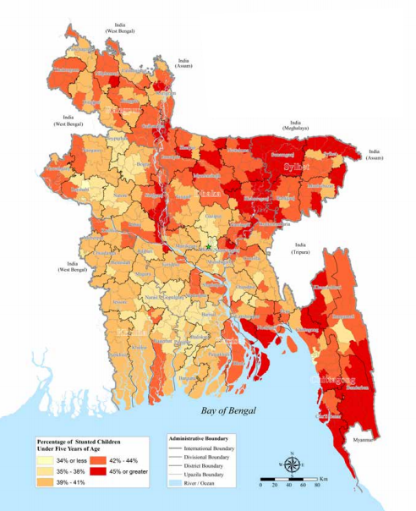
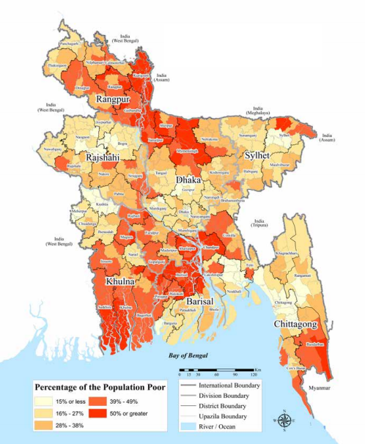
A paradox: stunting is highest in regions of lowest poverty, and vice versa
Child stunting
Poverty
Source: WFP 2012

Slide 16
Paradox is partly explained by regional difference in women’s empowerment
Sylhet Division: lowest women’s empowerment, second highest income
Barisal Division: second highest women’s empowerment, second lowest income
Source: IFPRI BIHS 2015

Slide 17
High rate of adolescent pregnancies is associated with stunting in Bangladesh
IFPRI BIHS data show:
58% of girls in rural areas get married before age 18
Adolescent girls aged <19 account for 36% of all child births in rural Bangladesh
Early marriage→ Early pregnancy → Low birthweight→ Stunting
Source: IFPRI BIHS 2015
Source: DHS 2014

Slide 18
Dietary Diversity Measures
IYCF indicators
 | Household DD | Women’s DD | Minimum DD | MAD
Target Population: | All household members | 15-49 years | 6-23 months | 6-23 months
# of Food Groups: | 12 | 9 | 7 | 6 (non-breastfed) 7 (breastfed)
Reference Period: | 24-hour recall | 24-hour recall | 24-hour recall | 24-hour recall
Proxy measure for food security
Individual measures are good indicators of diet quality

Slide 19
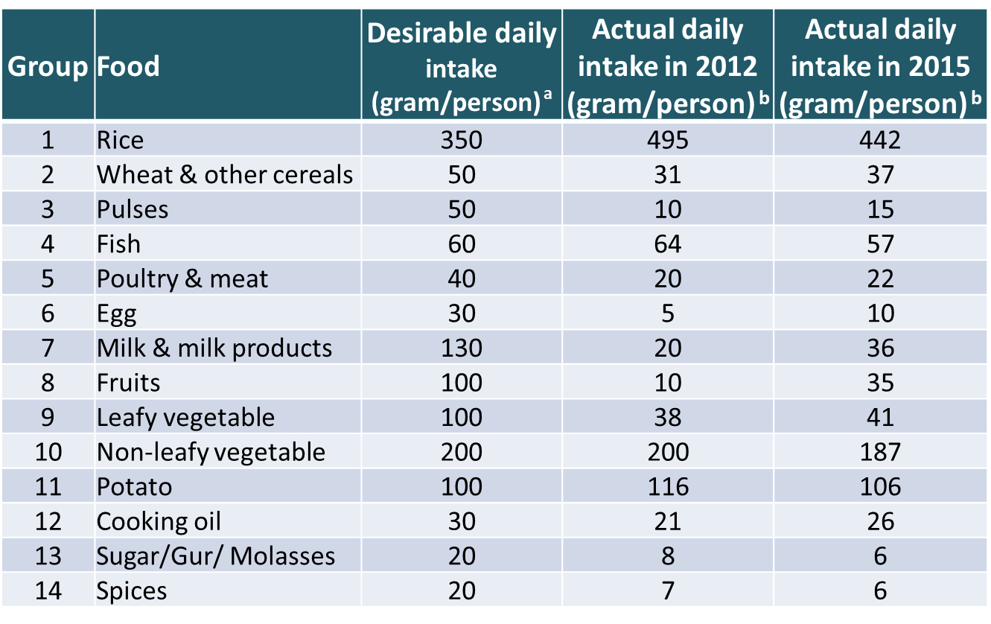
Desirable Dietary Patterns and Actual Food Intakes
Gaps reduced from 2011 to 2015
Source a: Desirable Dietary Patterns (DDP) 2013
Source b: IFPRI BIHS 2011 and 2015

Slide 20
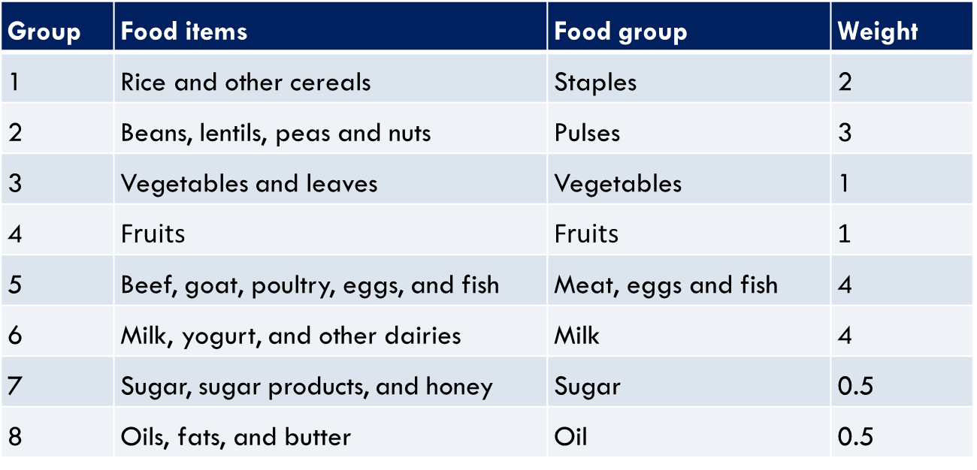
Calculation of the WFP Food Consumption Score to Measure Diet Quality
(# of days consumed of each food group in past 7 days, weighted by “nutritional importance”)

Slide 21

Household Diet Quality Improved
(Estimated WFP’s Food Consumption Score: 0-112)
Average FCS
Percentage of households with low FCS (<42)
Source: IFPRI BIHS 2011/12 and 2015

Slide 22
Household Diet Quality is Worse for the Poor, but Quality Improved for All
(using WFP’s Food Consumption Score: 0-112)
Source: IFPRI BIHS 2011/12 and 2015

Slide 23
Percentage of Households With Low Diet Quality Declined (using WFP’s Food Consumption Score: 0-112)
Source: IFPRI BIHS 2011/12 and 2015

Slide 24
Frequency of Food Groups Consumed in Past 7 Days Increased on Average
Source: IFPRI BIHS 2011/12 and 2015

Slide 25
Proportion of People Who Have Not Consumed Food Groups in Past 7 Days Declined
Average food consumption frequency hides severity
Source: IFPRI BIHS 2011/12 and 2015

Slide 26
What Factors Affect Diet Diversity?
Random-effects GLS Panel Regression Results
Dependent variable: Food Consumption Score

Slide 27
What Factors Affect Diet Diversity?
Using random effects panel regression, we estimated determinants of diet diversity using two different measures – FCS and HDDS. We obtain similar results from both regressions. We find that diet diversity improves if:
Household male head and female spouse have higher levels of education
Agricultural diversity increases: Household grew higher number of non rice food crops last year
Women are more empowered (measured by WEAI)
Rice price increases
Household have higher number of milking cows and are engaged in fisheries
Non-farm income share increases; have access to electricity, own cell phone and have higher asset holdings.

Slide 28
Males Have Higher Calorie Intake for All Age Groups
Source: IFPRI BIHS 2011/12
Notes:
Maybe delete.

Slide 29
But Females Have Slightly Higher Calorie Adequacy
(taking individual’s activity levels into account)
Source: IFPRI BIHS 2011/12
Notes:
Maybe delete.

Slide 30
Prevalence of Underweight is Higher Among Male, Except for the Elderly
(measured by BMI and age-specific cutoffs)

Slide 31
Prevalence of Underweight > Age 17 by Income (measured by BMI < 18.5)

Slide 32
Prevalence of Overweight Increases as Income Increases
(measured by BMI age-specific cutoffs)
Source: IFPRI BIHS 2011/12

Slide 33
Building Synergy Across Food Security Components:
Nutrition-Sensitive Agriculture and Nutrition-Sensitive Social Protection

Slide 34
Build Synergies Across 3 Components of Food Security
Access
Availability
Utilization
Food Security
Nutrition-Sensitive Agriculture
Nutrition-Sensitive
Social Protection

Slide 35
What are the main food availability and food access issues for nutrition in Bangladesh?
Availability
Bangladesh has made remarkable progress in foodgrain production, but improvements in child and maternal nutrition warrant further attention.
Agriculture provides a source of food and nutrients, a broad-based source of income, and affects food prices. Given these links, agriculture has the potential to be a strong driver of nutrition. However, that potential is not being realized.
Access
Social safety nets are important for improving food access for the poor, and have been quite effective in smoothing the consumption and the income of poor households in Bangladesh.
However, most existing evidence from evaluations (by IFPRI and others) of major safety nets in Bangladesh show few improvements in child nutritional status. This leads to a key question: Are there constraints other than income, such as nutrition knowledge, that also need to be addressed?

Slide 36
Influence of Agriculture on Diet Quality Evidence from IFPRI research in Bangladesh
Increased agricultural diversity improves household dietary diversity (Sraboni et al. 2014)
Increased women’s empowerment in agriculture (measured by WEAI) helps
  Improve household, child, and maternal dietary diversity; (Sraboni et al. 2014)
  Increase agricultural diversity (Ahmed & Sraboni 2014)
Nutrition behavior change communication (BCC) training for women and men improves household diet quality, child nutrition and complementary feeding practices (TMRI: Ahmed et al. 2016; A&T: Menon et al. 2016).

Slide 37
Agriculture, Nutrition, and Gender Linkages (ANGeL) Project: Background
Motivated by IFPRI research findings, IFPRI researchers developed a concept note for the Ministry of Agriculture to strengthen the agriculture-nutrition-gender nexus in June 2014.
Government approved ANGeL project in September 2015 for implementation by Ministry of Agriculture.
On October 29, 2015, Honorable Minister of Agriculture launched the ANGeL project.
ANGeL draws on the government’s nationwide agricultural extension network, ‘topping-up’ their portfolio with nutrition activities and messages.

Slide 38
ANGeL Project Design
ANGeL is a research project implemented by the Ministry of Agriculture in 16 of 64 districts in Bangladesh.
IFPRI evaluated impacts of 3 interventions and their 5 combinations using clustered randomized controlled trial (RCT) method. Interventions are:
  Agriculture Production: Facilitating the production of the high-value food commodities rich in essential nutrients. The focus is on diversifying agricultural production (fruits and vegetables, pulses, oilseeds, poultry, dairy, fish, livestock)
  Nutrition BCC: Imparting high-quality behavior change communication (BCC) to farmers to improve nutrition.
  Gender Sensitization: Undertaking activities to improve status of women, and gender parity between women and men.

Slide 39
Impacts of ANGeL
IFPRI-PRSSP evaluation of ANGeL found a number of positive impacts across the three target domains:
Agriculture: Improved knowledge of improved practices, especially among women, and increased crop diversity and production of non-staple crops
Income: Increased farm income from production of non-staple crops.
Nutrition: Improved knowledge, especially among women, and increased household diet quality and child diet diversity
Women’s empowerment: Women became more empowered in asset ownership and income decisions, men became more empowered in production and income decisions in select interventions.

Slide 40
ANGeL Policy Uptake
The ANGeL project is the first ministry-led initiative in Bangladesh that used a rigorous impact evaluation to develop an evidence base for designing and implementing a national program.
IFPRI presented the findings of ANGeL the evaluation in Dhaka in June 2018 in a dissemination seminar.
In January 2019, the Ministry of Agriculture approved expanding ANGeL nationally – in particular, rolling out the combination of interventions that were found to be most effective under ANGeL: trainings to men and women in farm households on improved agricultural production practices for high-nutritive-value crops, nutrition, and gender sensitization.
The workplan for scaling up ANGeL is being developed by the Ministry in consultation with IFPRI-PRSSP.

Slide 41
Nutrition-Sensitive Social Protection:
Transfer Modality Research Initiative (TMRI)
TMRI, designed by IFPRI and implemented by WFP from 2012-2014, generated definitive evidence on which safety net transfer modalities work best for the ultra-poor in rural Bangladesh: food or cash transfers – with or without intensive nutrition behavior change communication (BCC).
Results show combining cash income transfer and high quality nutrition knowledge is most effective at improving child nutrition:
  Cash + nutrition BCC led to a 7.3 percentage points decrease in child stunting over the project period—three times greater than national aver­age decline in stunting.
  Cash + BCC reduced intimate partner violence by 26%.

Slide 42
Adding BCC increases the frequency of several food groups consumed by children <42 months: North TMRI results

Slide 43
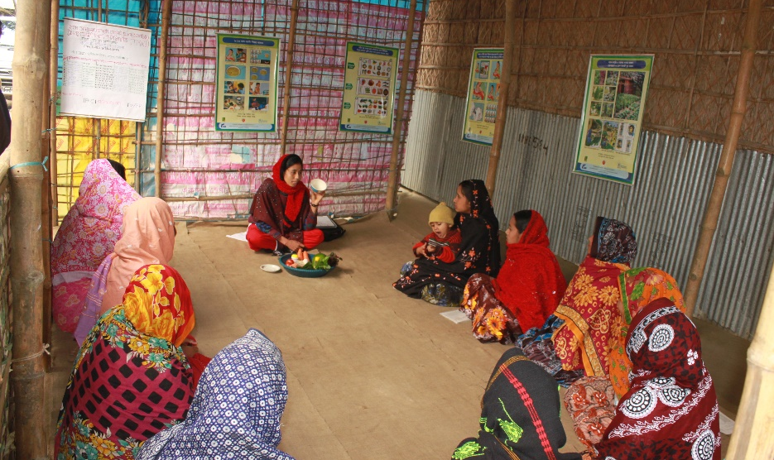
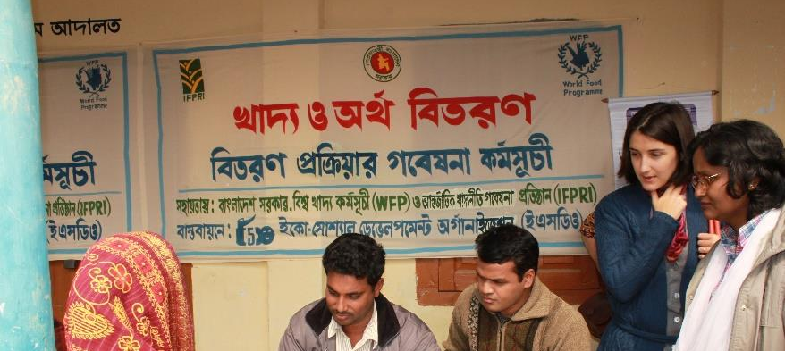
Policy Influence of TMRI
TMRI evidence is prompting the Bangladesh government and development partners to consider adding nutrition BCC into social protection programs.
For example, encouraged by TMRI results, the Ministry of Women and Children Affairs (MoWCA) added nutrition BCC to the Investment Component for Vulnerable Group Development (ICVGD) program for destitute women.

Slide 44
  Joint Interventions for Birth Outcomes on Nutrition (Jibon) Study
TMRI research in Bangladesh shows that cash transfer and high-quality nutrition behavior change communication (BCC) greatly improve child nutrition.
Yet a better understanding is needed on the effectiveness of different transfer packages and BCC towards improving maternal and newborn outcomes.
IFPRI has designed a randomized controlled trial for the Government’s Improved Maternity and Lactating Mother Allowance program (now termed Jibon) to assess how to best improve maternal and newborn outcomes.
Together with the Ministry of Women and Children Affairs (MOWCA) and WFP, IFPRI conducts the Jibon study targeting poor pregnant women in 7 rural upazilas (subdistricts).
Results may inform MOWCA on which design can most (cost-) effectively improve maternal and child health and nutrition in Bangladesh at scale.

Slide 45

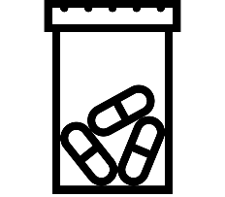




Jibon Study Interventions
Intervention 1:
Intervention 2:
Intervention 3:
Intervention 4:
Cash Tk800/month
MMS
Cash Tk800/month
MMS
BCC
Cash Tk800/month
MMS
BCC
Food Basket
Cash Tk800/month
MMS
BCC
Extra Cash Tk800

Slide 46
Policy Considerations for Improving Nutrition Security

Slide 47
Policy Considerations: Reduce Child Stunting
Child stunting in Bangladesh has dropped, but remains high at 31%.
Major causes of stunting in Bangladesh:
  Inadequate maternal nutrition during pregnancy.
  Inadequate infant and young child dietary intake.
To reduce child undernutrition, focus on:
  Improving maternal nutrition during pregnancy
  Improving child nutrition postnatally

Slide 48
Policy Considerations: Promote Nutrition-Sensitive Agriculture (1 of 3)
Promote agricultural diversity:
  Reduce risk of high-value, high nutritive value food production via contract farming, agricultural credit, etc.
  Create an enabling policy environment for the private sector for agricultural value chains development.
  Invest in research on productivity of rice, non-rice crops, livestock, and fisheries.
  Promote rice intensification and agricultural diversification via agricultural extension.

Slide 49
Policy Considerations: Promote Nutrition-Sensitive Agriculture (2 of 3)
Promote biofortified crop production
  HarvestPlus and BRRI developed 4 varieties of zinc-fortified rice.
  HarvestPlus is also working with BARI on biofortified lentil and sweet potatoes.
  Ministry of Food through its Public Food Distribution System (PFDS) can procure zinc-fortified rice from farmers at a premium price, which can incentivize farmers to grow biofortified rice.
Promote distribution of biofortified crops in safety nets
  PFDS can create institutional demand for biofortification by distributing zinc-fortified rice to safety net programs as PFDS outlets.

Slide 50
Policy Considerations: Promote Nutrition-Sensitive Agriculture (3 of 3)
The ANGeL project, designed by IFPRI and implemented by the Ministry of Agriculture, is promoting nutrition-sensitive agriculture.
Improve diet quality:
  Develop value chains for nutrient-dense foods.
  Promote nutrition knowledge among consumers, farmers, and women and men.
Support women’s empowerment:
  Women’s empowerment in agriculture improves dietary diversity, increases agricultural diversity, and helps households move out of poverty (IFPRI 2016). Therefore, promoting women’s empowerment remains paramount to attain complementary development goals.

Slide 51
Policy Considerations: Develop Nutrition-Sensitive Social Protection (1 of 2)
Revamp existing safety net programs:
  Add nutrition BCC to social protection, which covers
  Distribute fortified rice (pushti chal) through the Vulnerable Group Development (VGD) program and the Khaddya Bandhob (Food Friendly) Program.
Introduce school feeding program in secondary schools:
  School feeding program in Bangladesh currently operates only in primary schools.
  Introducing school feeding program in secondary schools is a promising platform to target nutrition interventions to reach adolescents, particularly girls.

Slide 52
Policy Considerations: Develop Nutrition-Sensitive Social Protection (2 of 2)
Improve targeting:
  Target the poor
  Target geographically: coastal belts, urban slums, low income areas.
  Target vulnerable population groups: using a lifecycle approach (adolescent girls, pregnant and lactating women).
Looking forward, design evidence-based safety nets to improve nutrition outcomes:
  GoB has committed to introduce a national Child Benefit Program under the National Social Security Strategy (NSSS). IFPRI and WFP are currently discussing with the Government on the design, which may include high quality nutrition BCC and targeting adolescent girls, and pregnant and lactating women.
Notes:
Add targeting point.

Slide 53
Policy Considerations: Prevent Early Marriage
Prevent early marriage of girls
  Pregnancy in girls who are still growing leads to competition between the mother and the fetus for access to nutrients, a battle which the fetus invariably loses, which leads to low birthweight.
  Low birthweight is strongly associated with child stunting.
  IFPRI’s qualitative results found that girls marry early due to (1) harassment by male youth, and (2) avoid paying higher dowry.
    A massive social campaign is needed to increase the age of marriage, as well as to postpone pregnancy of those girls who do marry early.
    To delay pregnancy after marriage, promote effective family planning.
Notes:
Compact2025 – determinants of nutrition.
Sanitary napkins.

Slide 54
Policy Considerations: Improve WASH and Caring Practices
Improve water, sanitation, and hygiene (WASH) practices
  Nutrition is not just food consumption; it’s also the ability to utilize and absorb nutrients. Improved WASH reduces the likelihood of infection (e.g., diarrhea), so the body is able to utilize the food consumed.
  Access to WASH is linked to child stunting reduction.
  Messages on WASH practices can be incorporated into high quality BCC programs.
Improve maternal and child care practices, such as exclusive breastfeeding for 6 months, infant and young child feeding (IYCF), provide workplace childcare options (e.g., target RMG sector), etc.

Slide 55
For more information, please contact: Akhter Ahmed
a.ahmed@cgiar.org | 01760744486
Thank you

