Slide 1



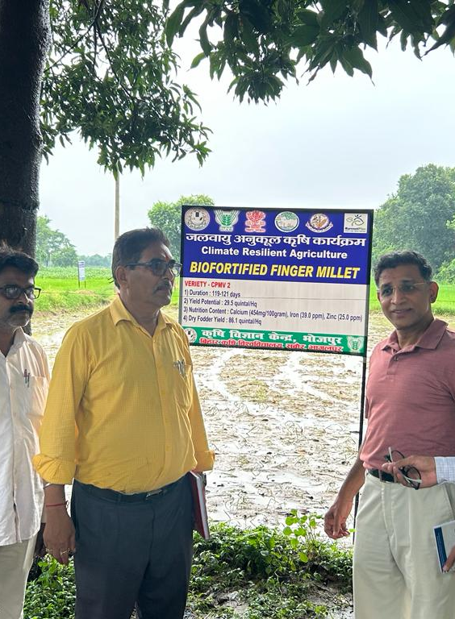
Keynote address: Digitalization and Climate Change Action: Global Experiences
Presented by Suresh Babu
Senior Research Fellow and Head of Capacity Building,
International Food Policy Research Institute (IFPRI)
Nov 2023
Presented to the USAID Mission
(Add Date)

Slide 2
Key areas of Presentation
Digitalization issues in Asia
G20 initiatives
Digitalization work with ERIA and Boomitra
CACCI-Asia: COP
Global South and Climate Smart Agriculture
Collaboration with TNAU and KVKs
Tajikistan-Methane Assessment at the District Level
Nutrition-Climate Change Linkages
China: Transforming and Upgrading Rural Industries
Concluding remarks

Slide 3
CLIMATE CHANGE AND Digitalization in Asia
Asia is one of the most vulnerable regions to climate change, and its impacts are projected to intensify in the future
Digital technologies can potentially unlock innovative solutions to complex development challenges brought by climate change
Climate-related data availability and access, and the availability of data analysts to process and generate insights from the data
Challenges: Lack of funding for climate adaptation initiatives that involve the use of digital technologies, lack of ICT policies that mainstream climate adaptation, Lack of climate change data and access, capacity gaps, weak regional cooperation
Notes:
Keynote address on Digitalization and Climate Change Action: Global Experiences in Vellore ( CACCI - Asia project)
15 slides: digitalization issues (more Asia-AGRA) and digitalization work with ERIA and Boomitra. Global picture—John Kerry (COP). What should global South do to prepare for CSA—1) EWS (rapid processing)- how farmers can protect; 2) digitalization of pest disease – app (Silvamuurli--- his youtube screenshot)- whatsapp—quickly responding to the extension system 3) mitigation and adapattion -KVK- prep TN 20 panchayats with TNAU – cell phone dig of awd and dsr- next stage; 4) boomitra- carbon market 5) Methane assessment at the district level- Tajikistan. Panchayat Academy pictures- farmer sitting on the floor; 6) Harvest Plus – Bihar. Hongmei proposal (add). Add g20 5 initiatives. Mousumi district level dashboards

Slide 4
G20 principles
Increased facilitation and collective action for humanitarian assistance to protect the food insecure and vulnerable population
Increased access to food and nutrition security through strengthening country-level safety net programs
Strengthened policies and actions towards sustainable and climate resilient food system transformation
Strengthening resilience and inclusivity in the agriculture and food value chains; and facilitating One Health approach
Notes:
Keynote address on Digitalization and Climate Change Action: Global Experiences in Vellore ( CACCI - Asia project)
15 slides: digitalization issues (more Asia-AGRA) and digitalization work with ERIA and Boomitra. Global picture—John Kerry (COP). What should global South do to prepare for CSA—1) EWS (rapid processing)- how farmers can protect; 2) digitalization of pest disease – app (Silvamuurli--- his youtube screenshot)- whatsapp—quickly responding to the extension system 3) mitigation and adapattion -KVK- prep TN 20 panchayats with TNAU – cell phone dig of awd and dsr- next stage; 4) boomitra- carbon market 5) Methane assessment at the district level- Tajikistan. Panchayat Academy pictures- farmer sitting on the floor; 6) Harvest Plus – Bihar. Hongmei proposal (add). Add g20 5 initiatives. Mousumi district level dashboards

Slide 5
Collaboration with eria and boomitra
With ERIA:
In 2023, G20-T20 International Workshop on ‘Enhancing Global Food Security through Climate Smart Agriculture, Digital Innovations, and New Institutional Governance’
Climate Resilient agriculture best practices and digital dashboard for selected ASEAN countries
An inventory of the policy and institutional interventions for the climate resilience strategy followed in each of the study countries. This inventory will be mapped against each country’s climate resilience agriculture policy and the commitments made towards UNFCCC.
A Functional dashboard that is useful to track progress made at the national level and for cross country learning purposes
With Boomitra:
Will work with Boomitra as a partner institution for involvement in the carbon credit market, and other potential partners to develop a mechanism to explore involving farmers who are able to reduce CO2 emissions and can participate in the carbon credit market.
Notes:
Keynote address on Digitalization and Climate Change Action: Global Experiences in Vellore ( CACCI - Asia project)
15 slides: digitalization issues (more Asia-AGRA) and digitalization work with ERIA and Boomitra. Global picture—John Kerry (COP). What should global South do to prepare for CSA—1) EWS (rapid processing)- how farmers can protect; 2) digitalization of pest disease – app (Silvamuurli--- his youtube screenshot)- whatsapp—quickly responding to the extension system 3) mitigation and adapattion -KVK- prep TN 20 panchayats with TNAU – cell phone dig of awd and dsr- next stage; 4) boomitra- carbon market 5) Methane assessment at the district level- Tajikistan. Panchayat Academy pictures- farmer sitting on the floor; 6) Harvest Plus – Bihar. Hongmei proposal (add). Add g20 5 initiatives. Mousumi district level dashboards

Slide 6
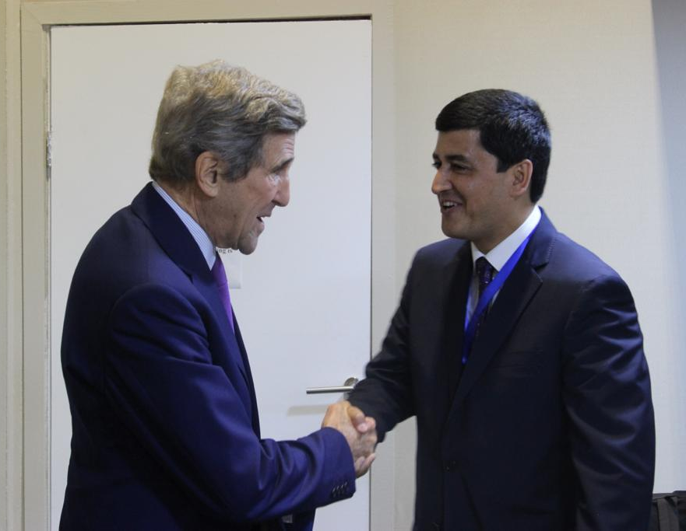
CACCI-Asia: Tajikistan
    NDC Secretariat
    COP27-Tajikistan Pavilion
    Research papers
    Stakeholder engagement
    Sectoral integration
    Methane Assessment Study
    Planned methane assessment studies at the district level

Slide 7
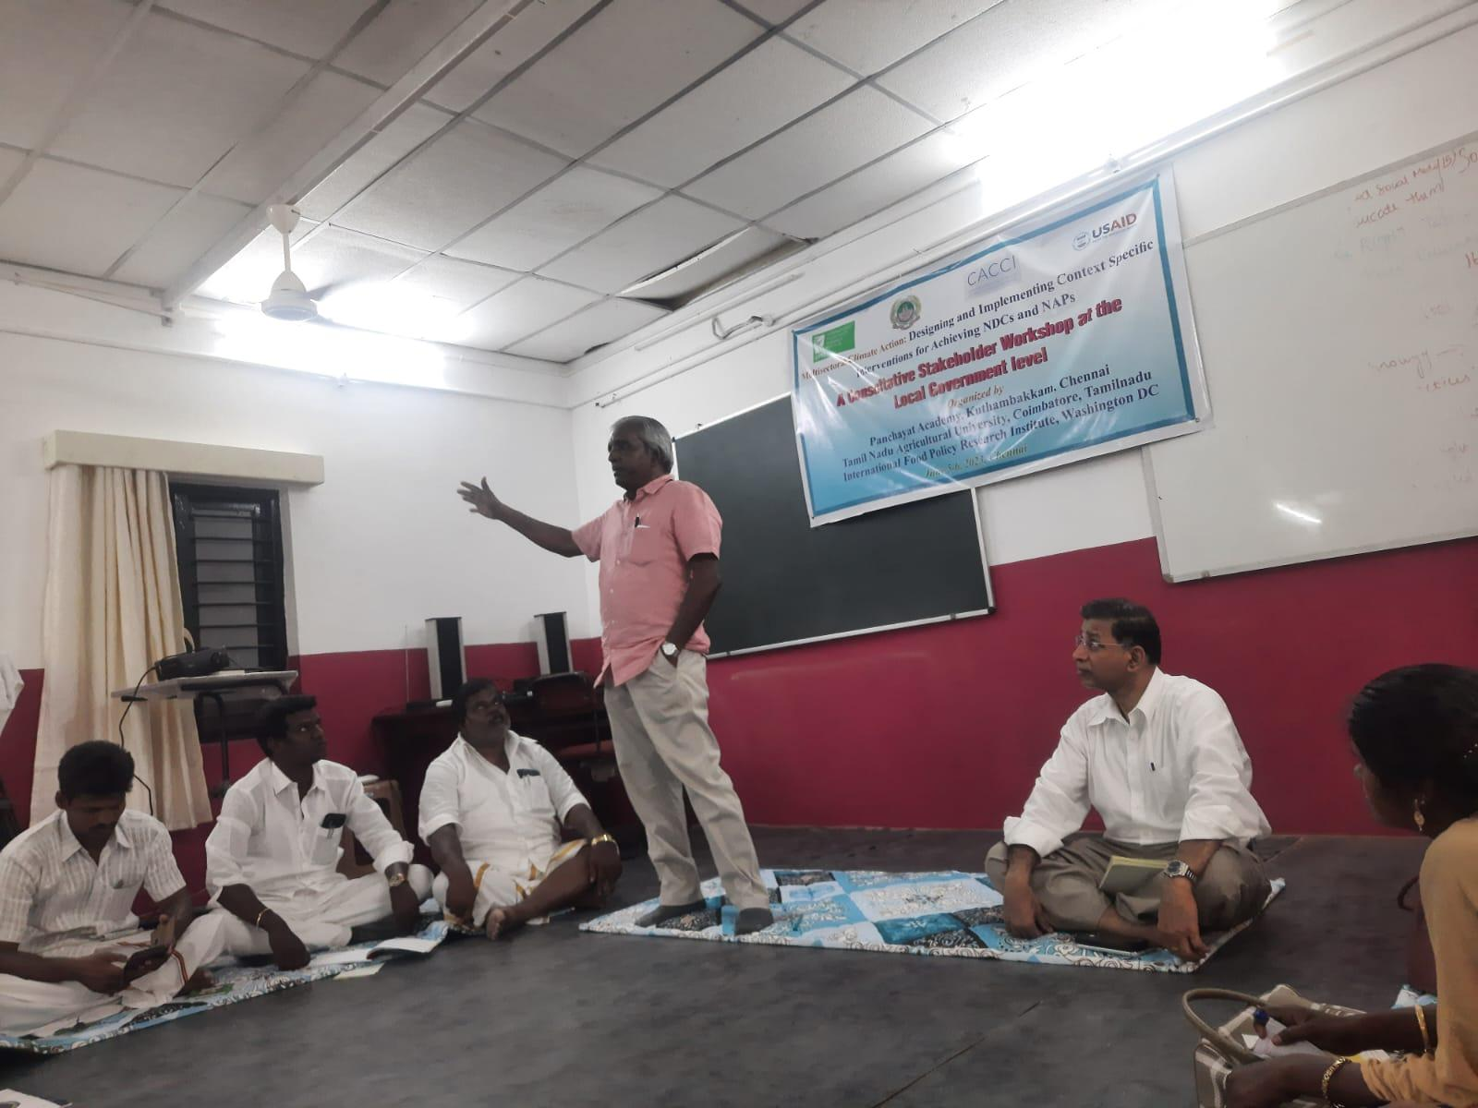
Global south and climate smart agriculture
Early Warning Systems (rapid processing)
Digitalization of pest disease -quickly responding to the extension system
Mitigation and adaptation -KVK- preparing 20 panchayats in the state of Tamil Nadu in collaboration with TNAU.
Focus on developing mobile app for AWD and DSR in the next stage
Boomitra- carbon market
Methane assessment at the district level- Tajikistan
Notes:
Keynote address on Digitalization and Climate Change Action: Global Experiences in Vellore ( CACCI - Asia project)
15 slides: digitalization issues (more Asia-AGRA) and digitalization work with ERIA and Boomitra. Global picture—John Kerry (COP). What should global South do to prepare for CSA—1) EWS (rapid processing)- how farmers can protect; 2) digitalization of pest disease – app (Silvamuurli--- his youtube screenshot)- whatsapp—quickly responding to the extension system 3) mitigation and adapattion -KVK- prep TN 20 panchayats with TNAU – cell phone dig of awd and dsr- next stage; 4) boomitra- carbon market 5) Methane assessment at the district level- Tajikistan. Panchayat Academy pictures- farmer sitting on the floor; 6) Harvest Plus – Bihar. Hongmei proposal (add). Add g20 5 initiatives. Mousumi district level dashboards

Slide 8
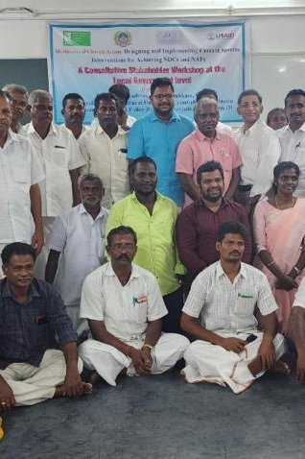
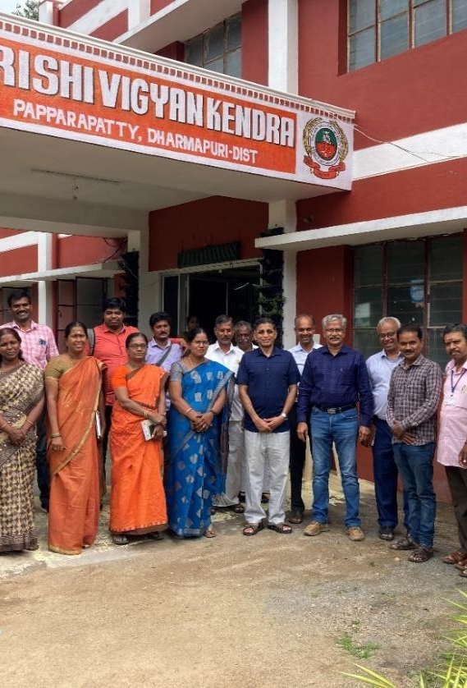
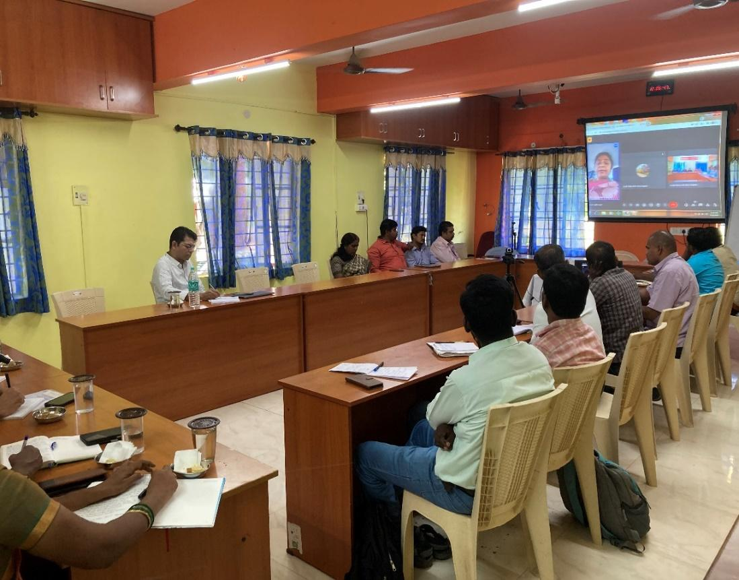
Collaboration with TNAU and kvks
Consultative Stakeholder Workshop on ‘Multisectoral Climate Action: Designing and Implementing Context Specific Interventions for Achieving NDCs and NAPs’
G20-T20 International Workshop on ‘Enhancing Global Food Security through Climate Smart Agriculture, Digital Innovations, and New Institutional Governance’
In collaboration with TNAU and associated KVKs collaborate on methane emission reduction in rice farming systems in 20 Panchayats in Tamil Nadu
Notes:
Keynote address on Digitalization and Climate Change Action: Global Experiences in Vellore ( CACCI - Asia project)
15 slides: digitalization issues (more Asia-AGRA) and digitalization work with ERIA and Boomitra. Global picture—John Kerry (COP). What should global South do to prepare for CSA—1) EWS (rapid processing)- how farmers can protect; 2) digitalization of pest disease – app (Silvamuurli--- his youtube screenshot)- whatsapp—quickly responding to the extension system 3) mitigation and adapattion -KVK- prep TN 20 panchayats with TNAU – cell phone dig of awd and dsr- next stage; 4) boomitra- carbon market 5) Methane assessment at the district level- Tajikistan. Panchayat Academy pictures- farmer sitting on the floor; 6) Harvest Plus – Bihar. Hongmei proposal (add). Add g20 5 initiatives. Mousumi district level dashboards

Slide 9
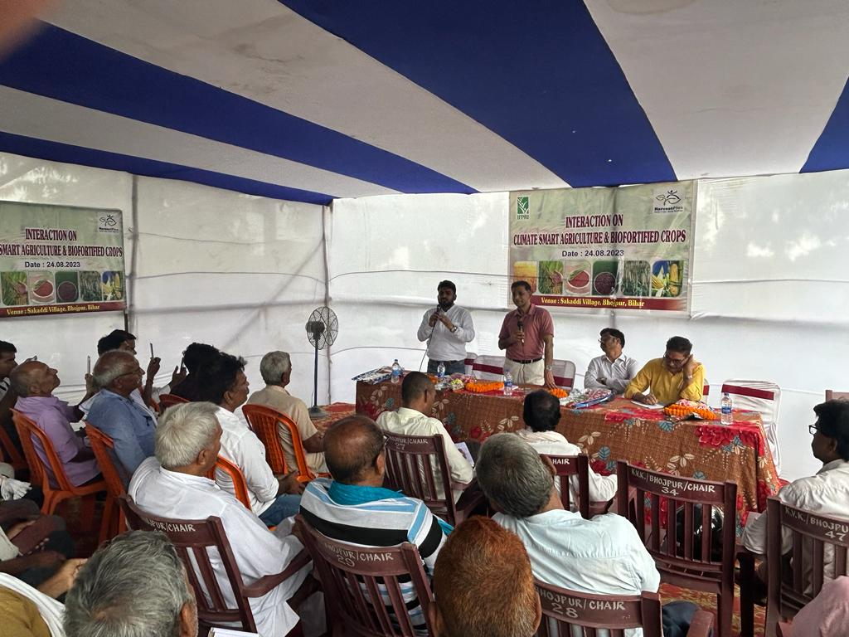
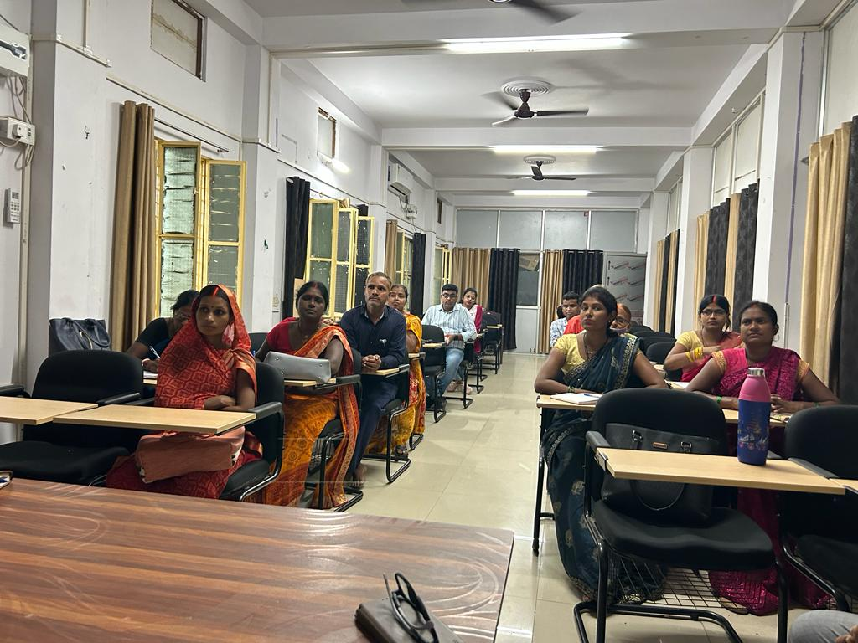
Nutrition-climate change linkage
Notes:
Keynote address on Digitalization and Climate Change Action: Global Experiences in Vellore ( CACCI - Asia project)
15 slides: digitalization issues (more Asia-AGRA) and digitalization work with ERIA and Boomitra. Global picture—John Kerry (COP). What should global South do to prepare for CSA—1) EWS (rapid processing)- how farmers can protect; 2) digitalization of pest disease – app (Silvamuurli--- his youtube screenshot)- whatsapp—quickly responding to the extension system 3) mitigation and adapattion -KVK- prep TN 20 panchayats with TNAU – cell phone dig of awd and dsr- next stage; 4) boomitra- carbon market 5) Methane assessment at the district level- Tajikistan. Panchayat Academy pictures- farmer sitting on the floor; 6) Harvest Plus – Bihar. Hongmei proposal (add). Add g20 5 initiatives. Mousumi district level dashboards

Slide 10
China: Digital interventions
Project Title: The Path of the Transformation and Upgrading (TaU) of Rural Industries and Strategies to Facilitate the TaU in the Era of Digitalization.
Project Objectives:
This project aims to identify the paths of TaU of rural industries and investigate the strategies to facilitate the TaU of China’s rural industries in the era of digitalization. To achieve the goal, this project has five sub-projects:
(1) The Path of TaU of Rural Industries: China’s Path and Experiences from Other Countries;
(2) The Impact of Digital Technologies on Agricultural TaU and Its Mechanisms;
(3) The Impact of Digital Technologies on the Integration of the Primary, Secondary, and Tertiary Industries in Rural Areas and Its Mechanisms;
(4) The Strategies to Facilitate the TaU of Rural Industries;
(5) Policy Recommendations on the Paths of the TaU of Rural Industries in China and Implications for Other Developing Countries in the Era of Digitalization
Notes:
Keynote address on Digitalization and Climate Change Action: Global Experiences in Vellore ( CACCI - Asia project)
15 slides: digitalization issues (more Asia-AGRA) and digitalization work with ERIA and Boomitra. Global picture—John Kerry (COP). What should global South do to prepare for CSA—1) EWS (rapid processing)- how farmers can protect; 2) digitalization of pest disease – app (Silvamuurli--- his youtube screenshot)- whatsapp—quickly responding to the extension system 3) mitigation and adapattion -KVK- prep TN 20 panchayats with TNAU – cell phone dig of awd and dsr- next stage; 4) boomitra- carbon market 5) Methane assessment at the district level- Tajikistan. Panchayat Academy pictures- farmer sitting on the floor; 6) Harvest Plus – Bihar. Hongmei proposal (add). Add g20 5 initiatives. Mousumi district level dashboards

Slide 11
Concluding remarks
Digitization is key for transformation of food systems
Climate crisis requires information sharing in a timely manner to adapt and to mitigate
Digitization requires institutional and regulatory mechanisms as shown by the recent developments in AI
Innovation in the form of rural apps and connecting challenges to the solutions from research is key for successful digitization
The future is in the hands the new generation which already digital savvy but requires thematic and data analytical skills

Slide 12
THANK YOU

